Slide 1
Module 1
FMP Introduction and Overview
Notes:
Narration:
“Welcome to North American Fatigue Management Program, Introduction and Overview. Thank you for taking the time to learn more about fatigue and its effects on drivers. The NAFMP was developed through collaboration between carriers, the insurance industry, and government, and is based on significant real time research in the carrier operating environment. Fatigue management is essential for truck and bus drivers, both for their safety and for their long-term health.”

Slide 2
Module 1 Overview
Introduction to Fatigue
Overview of Fatigue Management Program
Module Summaries
Notes:
Narration:
“This module provides an overview of the North American Fatigue Management Program. This overview will start with a brief introduction to fatigue, including: a description of the characteristics of fatigue, the health and wellness implications of fatigue, the benefits of using a fatigue management program (or FMP), and an overview of the FMP. Then there will be a short overview of the implementation manual that accompanies the FMP. Finally, a summary of major topics for each of the nine modules in the FMP will be outlined.”
______________________________________
Key Points:
Introduction to include definition of fatigue, characteristics of fatigue, health and wellness implications of fatigue, benefits of an FMP, and an overview of the FMP
The overview of the implementation manual will discuss the purpose of the implementation manual and a brief overview.
Summaries of the modules will discuss major topics included

Slide 3
List of Abbreviations and Acronyms
CMV | commercial motor vehicle
FMP | Fatigue Management Program
FMT | fatigue management technology
HOS | hours-of-service
OSA | Obstructive Sleep Apnea
Notes:
Narration:
“This is a list of abbreviations and acronyms that appear throughout this module. You may print this page for your reference throughout the module.“

Slide 4
Module Objectives (1 of 2)
Define Fatigue Management Program (FMP)
Identify need for fatigue management in Commercial Motor Vehicle (CMV) operations
Identify benefits of implementing the FMP
Identify importance of the corporate change process, driver scheduling, fatigue management training, and sleep apnea screening and treatment
Identify major elements of the FMP
Identify what is in the implementation manual
Identify major topics covered in each module
Notes:
Narration:
“After this overview module, you will be able to: define what the fatigue management program (FMP) is, identify why fatigue management is important in commercial motor vehicle (or CMV) operations, identify the major benefits from implementing the FMP, identify the importance of the corporate culture change process, driver scheduling, fatigue management training, and sleep apnea screening and treatment, identify the major elements of the FMP, identify what is in the implementation manual, and identify the major topics covered in each of the nine modules included in this FMP.”

Slide 5
Module Objectives (2 of 2)
Identify how the FMP assesses your learning in each module
Identify which modules are designed for drivers, carrier executives and managers, drivers’ families, trainers, shippers and receivers, and dispatchers
Notes:
Narration:
“Additionally, you will be able to: identify how the FMP assesses your learning in each module, identify which modules are designed for drivers, and identify which modules are designed for carrier executives and managers.”

Slide 6
Lesson 1: Fatigue
Notes:
Narration:
“We begin by looking at fatigue, its characteristics, and how it can affect a driver’s health and wellness.”

Slide 7
Introduction to Fatigue
What is fatigue?
Combination of symptoms
Decreased alertness
Decreased attention to the environment
Reduced performance
Reduced motivation
Irritability
Impaired judgment
Feelings of drowsiness
Notes:
Narration:
“Fatigue is a feeling of drowsiness or sleepiness, and can best be described as a combination of symptoms. The first symptom of fatigue is decreased alertness. Alertness is when you are awake and attentive. Therefore fatigue is when you are sleepy and less attentive to the environment. In other words, feeling fatigued is the opposite of feeling alert. In terms of CMV driving, an example of decreased alertness may be if the driver misses an exit.
The second symptom of fatigue is decreased attention to the environment. For example, a driver may not have noticed another vehicle’s turn signal turn indicating their intent to change lanes.
A third symptom of fatigue is reduced performance. For example, a driver may have inadequately braked to a potentially hazardous situation.
A fourth symptom of fatigue is reduced motivation. For example, a fatigued driver may be less motivated to perform a walk around safety check/inspection before driving off to make a delivery.
Fifth, fatigue causes irritability. A CMV example of increased irritability from fatigue is a driver becomes easily agitated about other drivers’ actions on the road.
Sixth, fatigue impairs judgment. Obviously, driving requires a great deal of judgment, and fatigue may cause a driver to make poor decisions. For example, a driver may select an inappropriate defensive driving maneuver in response to a potential crash threat.
Finally, fatigue increases feelings of drowsiness. Therefore, fatigue can increase the chances of a driver falling asleep behind the wheel.”
______________________________________
Key Points:
fatigue is a feeling of drowsiness or sleepiness, and is not physical exhaustion.
fatigue is a combination of symptoms including…
alertness is when you are awake and attentive. Fatigue is then when you are sleepy and less attentive to the environment.
CMV examples of symptoms include:
decreased alertness – missing your exit
decreased attention to environment – did not notice another vehicle’s turn signal on
reduced performance – inadequate braking to a potentially hazardous situation
reduced motivation – reduced motivation to perform walk arounds
irritability – may be more likely to become agitated about other drivers’ actions
impaired judgment – may not recognize a potential crash threat
feelings of drowsiness - sleepiness

Slide 8
Fatigue vs. Sleepiness
Fatigue may also be physical and felt in the body
De-energized, sore, achy
Sleepiness felt in mind
Heavy eyes, difficulty concentrating
Physical fatigue is generally not the main problem, while sleepiness and mental fatigue are
Notes:
Narration:
“As mentioned on the previous slide, fatigue is a feeling of drowsiness. However, there actually is a distinction between fatigue and sleepiness. Fatigue is usually believed to be physical, therefore, being felt in the body. For example, when you feel de-energized, sore, or achy after physical exertion. Sleepiness, on the other hand, is felt in the mind. For example, when you have heavy eyes or have difficulty concentrating. Sometimes this distinction can become clearer when you label the two terms physical fatigue versus mental fatigue.
This distinction is important because there are different ways to treat physical fatigue and sleepiness. Just obtaining sleep alone can alleviate feelings of sleepiness, but resting the body’s muscles and obtaining sleep may both be needed to restore alertness from physical fatigue. With physical fatigue you will want to rest without having the urge to sleep. While there is a distinction between physical fatigue and sleepiness, this FMP addresses both. However, from this point forward, the FMP will use the term fatigue interchangeably.
When it comes to CMV operations, physical fatigue is generally not the major problem, while sleepiness and mental fatigue are. Thus, the majority of this FMP will be geared toward understanding mental fatigue and driver sleepiness, the implications of mental fatigue and sleepiness in relation to driving, and the management of drivers’ mental fatigue and sleepiness.”
______________________________________
Key Points:
Sleep can alleviate feelings of sleepiness which is not always true with physical fatigue (you’ll want to rest to alleviate fatigue without necessarily the urge to sleep).
While there is a distinction between fatigue and sleepiness, the FMP addresses both. However, the FMP will use the term fatigue to address both.

Slide 9
Characteristics of Fatigue (1 of 2)
Acute (short-term) fatigue
May be experienced daily
Reduced or eliminated by a night’s sleep or nap
Caffeine or rest (without sleep) may temporarily perk up alertness
But obtaining sleep is important to alleviate acute fatigue
Chronic (long-term) fatigue
Inadequate sleep, or sleep deprivation, over weeks/months
Personal, home life, or work-related stressors may contribute
Need a few nights of long, sound sleep or break from work
May be linked to obstructive sleep apnea (OSA) or other sleep disorders
Notes:
Narration:
“There are two different types of fatigue, acute or short-term fatigue and chronic or long-term fatigue. Acute fatigue may be experienced daily and weekly by most people and is caused by normal activities. Acute fatigue can be reduced or eliminated altogether by one night’s sleep or a mid-day nap. Acute fatigue may also be reduced with caffeine consumption or simply with rest without any sleep.
On the other hand, chronic fatigue is likely due to inadequate sleep over longer periods of time, called sleep deprivation. Sleep deprivation is when you consistently do not get enough sleep over a period of time. In spite of the requirement for, and allowance to gain adequate rest within hours-of-service (or HOS) regulations, chronic fatigue may also result from other factors such as personal, home life, medical, or work-related issues. In order to recover from chronic fatigue, you need a few nights of long, sound sleep or a break from work, such as a vacation. Furthermore, sleep deprivation or chronic fatigue may be caused by a sleep disorder, the most common of which is obstructed sleep apnea (or OSA). OSA is when your breathing stops during sleep due to an obstruction of the throat. OSA is characterized by repeated closures of the upper airway that last approximately 10 seconds or more each time.”
______________________________________
Key points:
OSA - breathing stops during sleep due to obstruction of the throat. Repeated closures of the upper airway that last ~10 seconds.

Slide 10
Characteristics of Fatigue (2 of 2)
Loss of alertness, attention, and vigilance
Reduced field-of-vision
Wandering thoughts/boredom
Loss of motivation
Slow reactions, poor response
Impaired judgment
Adversely affects safe driving practices
Impaired memory
Occasionally experience microsleeps
Little effect on purely physical tasks
Notes:
Narration:
“Another major characteristic of driver fatigue is a loss of alertness, attention to the driving task, and driving vigilance. Even a slight decrease in alertness and watchfulness may mean the difference in life or death in a crash. When drivers are fatigued they may not recognize a hazard fast enough to take evasive action. Other characteristics of fatigue include a reduced field-of-vision, an increase in wandering thoughts and boredom, loss of motivation, slow reactions, and poor responses.
Fatigue may also cause impaired judgment that may adversely affect safe driving practices, impaired memory, and microsleeps. Mircosleeps are intermittent short losses of consciousness. You “nod off” for a few seconds. Microsleeps become longer, more frequent, and more dangerous with greater fatigue. Note, however, that fatigue has little effect on purely physical tasks such as walking or lifting.”
While mental fatigue has little effect on the performance of purely physical tasks, fatigue impacts many things critical to driving, such as judgment and field-of-vision. These general characteristics of fatigue may cause the driver to make unsafe actions, and these unsafe actions can then lead to injury.”
______________________________________
Key Points:
A major characteristic of driver fatigue is a loss of alertness, attention to the driving task, and vigilance. Even a slight decrease in alertness and vigilance may mean the difference in life or death in a crash. When drivers are fatigued, they may not recognize a hazard fast enough to take evasive actions.
While fatigue has little effect on purely physical tasks, fatigue does impair judgment which may cause the driver to take unnecessary short-cuts. These short-cuts can then lead to injury.

Slide 11
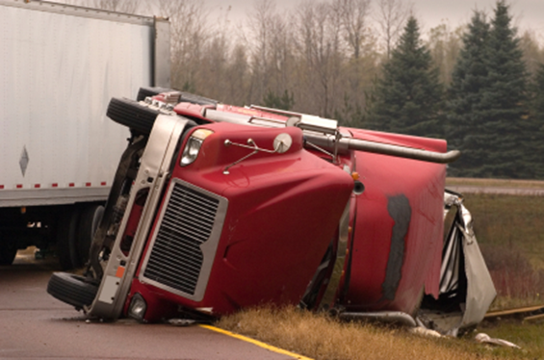
How Fatigue Affects Commercial Motor Vehicle Fleets
Fatigue’s role in crashes
Principal cause in 31% fatal-to-the-driver large truck crashes (NTSB, 1990)
Asleep-at-the-wheel in 4% of heavy vehicle crashes (Knipling & Wang, 2004)
Associated factor in 13% of serious heavy vehicle crashes (FMCSA, 2006)
Fatigue-related crashes may be result of:
Lack of sleep/sleep disorders
Extended driving hours
Switching day and night shifts
without time to adjust
Work conditions
Notes:
Narration:
“Now that you know what fatigue is, it is important to discuss how fatigue impacts CMV operations. Several studies have shown that fatigue plays a role in large vehicle crashes. For example, in 1990 the National Transportation Safety Board studied 182 fatal-to-the-driver large truck crashes. Their in-depth investigations revealed fatigue to be a principal cause in 31% of these crashes. More recent research has found that in four percent of heavy vehicle crashes drivers were asleep-at-the-wheel. Additionally, the large truck crash causation study found that driver fatigue was an associated factor in 13 percent of heavy vehicle crashes that resulted in injuries or fatalities.
Several reasons may explain why driver fatigue can contribute to a CMV crash. First, CMV drivers may lack an adequate amount of sleep. Second, drivers may have a sleep disorder such as obstructive sleep apnea. Third, some drivers may not always drive the same shift, switching between day and night shifts. This can disrupt the driver’s normal circadian rhythm. Finally, some operations may inadvertently encourage fatigued driving through their policies. Considering that the daily and weekly HOS regulation requirements allow drivers the opportunity to get the sleep they need, the FMP gives additional guidance and support to achieve the rest they need”

Slide 12
Health and Wellness Issues (1 of 2)
Disrupts circadian rhythm
Increased blood pressure
Increased risk of heart disease
Gastrointestinal problems
Increased calorie consumption
Weight gain
Type II diabetes
Poor immune system function
Notes:
Narration:
“Not only can fatigue contribute to CMV crashes, but a number of health issues can at least in part be linked to chronic sleep deprivation. These include: disruption of normal circadian rhythm, increased blood pressure, increased risk of heart disease, gastrointestinal problems, increased calorie consumption, weight gain, type II diabetes, and decreased function of the immune system.”
______________________________________
Principal source: Saltzman and Belzer, 2007.

Slide 13
Health and Wellness Issues (2 of 2)
More likely to smoke & use alcohol
Irritability and depression
Disrupts relationships
Worsens psychiatric conditions
Decreased quality of life
Increased sick days
Notes:
Narration:
“Additional health and wellness issues associated with chronic sleep deprivation: drivers are more likely to smoke and use alcohol, increased irritability, increased chances of depression, increased chances of relationship problems, a worsening of psychiatric conditions such as anxiety, decreased quality of life, and an increase in the number of sick days used.
By targeting sleep deprivation, this FMP addresses many aspects of these health and wellness implications in numerous modules.”

Slide 14
Lesson 2: FMP
Notes:
Narration:
“Next we will take a closer look at the FMP.”

Slide 15
FMP Overview
No simple solution to mitigate driver fatigue
A comprehensive approach to effectively manage fatigue
Corporate culture
Education and training
Sleep disorder screening and treatment
Scheduling and tools
Fatigue monitoring and management
technologies
Collaboration between drivers, families, management, dispatchers, and customers
Applicable regardless of industry type and fleet size
Benefits can be found if implemented appropriately
Notes:
Narration:
“CMV driver fatigue is a serious issue that affects all motorists on the roadway. One means to respond to driver fatigue is through the HOS rules. HOS regulations give drivers the opportunity to get the rest/sleep they need; however, the FMP provides additional tools and techniques that drivers may need to make the best use of the rest/sleep under HOS regulations. With this in mind, the FMP addresses the issue of driver fatigue with a comprehensive approach that includes: (1) information on how to develop a corporate safety culture that facilitates reduced driver fatigue, (2) fatigue management education and training for drivers, drivers’ families, carrier executives and managers, shippers and receivers, and dispatchers, (3) information on sleep disorders screening and treatment, and (4) driver and trip scheduling information.
Because driver fatigue is a very complex issue, it is critical for collaboration between drivers, drivers’ families, management, dispatchers, and customers. With this collaboration, driver fatigue can be approached from all angles to achieve the most success.
This FMP is applicable to all CMV operations regardless of industry type and fleet size. Benefits from this FMP can be achieved as long as the FMP is implemented appropriately and tailored to your specific organization.”
______________________________________
Key Points:
Fatigue is serious issue to all motorists on the roadway.
One means to responding to driver fatigue are the hours of service (HOS) rules. Research has shown that other factors are involved in fatigue, and that there is no simple solution to reducing driver fatigue and improving safety performance.
The FMP addresses the issue of driver fatigue with a comprehensive approach that includes:
Developing a corporate safety culture that facilitates reduced driver fatigue
Education and training of drivers, drivers’ families, carrier executives and managers, shippers and receivers, and dispatchers
Driver and trip scheduling
Sleep disorders screening and treatment

Slide 16
Benefits of an FMP
Safety
Reduced fatigue-related risks
Improved driver alertness
Reduced crashes and near crashes
Health and well-being
Increased job and life satisfaction
Fewer health complications
Weight loss
Financial
Reduced legal exposure
Lower healthcare and crash costs
Increased productivity through reduced absenteeism
Notes:
Narration:
“There are three areas where this FMP can benefit your organization if implemented successfully: safety, driver health and well-being, and financially. In terms of safety, the information included in the FMP will help to reduce fatigue-related risks, such as OSA. The FMP will also improve driver alertness and his or her ability to make quick, accurate decisions on the road. Thus, the FMP will help reduce driver fatigue and may reduce the number of fatigue-related crashes.
In terms of driver health and wellbeing, the FMP will help to increase drivers’ job and life satisfaction. Drivers will experience fewer health complications, such as lower incidence of driver hypertension. Additionally, drivers are likely to exhibit improved weight management.
Financially, the FMP will reduce your organization’s legal exposure through a reduction in fatigue-related crashes. Your organization will experience lower healthcare and crash costs. Driver absenteeism will also be reduced because they are healthier and happier.”
______________________________________
Fourie, C., Holmes, A., & Bourgeois-Bougrine, S. (2010). Road Safety Research Report No. 110. Fatigue Risk Management Systems: A Review of the Literature. London: Department of Transport.

Slide 17
FMP Format
FMP information organized in a series of modules covering different fatigue topics
Instruction options
Instructor-led PowerPoint presentation
Web-based non-interactive course
Web-based interactive course
Quizzes to assess learning
End of lesson tests
Notes:
Narration:
“The information included in the FMP is organized into a series of learning modules that cover different fatigue topics, such as driver education and trip scheduling. Some modules present the same information but in a slightly different way to several different audiences. Some modules are directed toward carrier management while others are directed to drivers. There are three different instructional options for the FMP. The first option is an instructor-led PowerPoint presentation. This instruction method relies on a trainer to present the FMP PowerPoint presentation to students. Typically, a CMV trainer is used to lead this method. The second instructional option is a web-based non-interactive course. This method is the same FMP PowerPoint presentation as the Instructor-led version, but it is housed online with a complete voiceover narration. This method is self-paced and is not led by an instructor. Typically, this method is used by owner-operators or small CMV operations. The third instructional option is a web-based interactive course with a complete voice-over narration. This method is also self-paced and housed online, but, it is designed to be interactive. This method can be used by anyone with internet access.
The FMP incorporates periodic quizzes on course material and lesson tests.

Slide 18
Implementation Manual
Step-by-step guide for implementing an FMP
For carrier management, including:
President/CEO
Safety managers
Fleet managers
Logistics managers
Transportation managers
Practical, easy-to-understand reference guide
Notes:
Narration:
“To facilitate the implementation of a comprehensive FMP, a step-by-step manual was developed for use by carrier management, including: the president/CEO, safety managers, fleet managers, logistics managers, and transportation managers. The manual is a practical, easy-to-understand reference guide for implementing the FMP.”

Slide 19
Overview of the Implementation Manual
Definition and benefits of an FMP
Role of safety culture
Roles and responsibility in an FMP
Performance measures and rewards in an FMP
Risk management
Guide to corporate culture change
How to select trainers
Step-by-step guide to implement a sleep disorders screening and treatment program
Notes:
Narration:
“The implementation manual will discuss the definition and benefits of the FMP and will detail the following topics: the importance of an organization’s safety culture in determining the success of the FMP, the roles and responsibilities of different people in a successful FMP, different performance measures and rewards in the FMP, risk management and the FMP, a step-by-step guide to corporate culture change, methods to select trainers to deliver the FMP, and a step-by-step guide on how to develop and implement a sleep disorders screening and treatment program.”

Slide 20
Lesson 3: Module Summaries
Notes:
Narration:
“Next we will take a closer look at the modules that make up the FMP.”

Slide 21
Instructional Modules
Module | Title | Target Audience | Estimated Duration
1 | FMP Introduction and Overview | Carrier Executives and Managers | 45 minutes
2 | Safety Culture and Management Practices | Carrier Executives and Managers | 1.5 hours
3 | Driver Education | Drivers | 3 hours
4 | Driver Family Education | Drivers’ Spouses and Family | 45 minutes
5 | Train-the-Trainer for Driver Education and Family Forum | Trainers | 3.5 hours
6 | Shippers and Receivers | Shippers and Receivers | 30 minutes
7 | Motor Carrier Sleep Disorders Management | Carrier Executives and Managers | 1.5 hours
8 | Driver Sleep Disorders Management | Drivers | 1.25 hours
9 | Driver Scheduling and Tools | Dispatchers and Managers * | 1 hour
10 | Fatigue Monitoring and Management Technologies | Carrier Executives and Managers | 1 hour
Notes:
Narration:
“The FMP includes a total of 10 different modules, including this overview, that are targeted to specific audiences. These topics include: an overview of safety culture and management practices necessary for a successful FMP, fatigue management education and training, sleep disorders screening and treatment, driver scheduling and tools, and fatigue monitoring and management technologies. The FMP is designed for 9 hours and 15 minutes of instruction for carrier management, 4 hours and 15 minutes of instruction for drivers, 45 minutes of instruction for drivers’ families, 30 minutes of instruction for shippers and receivers, and 1 hour of instruction for dispatchers. In addition to Module 3 and 8, Module 9 is an advanced module for drivers if they are interested.”
______________________________________
*Module 9 is an advanced module for drivers if interested

Slide 22
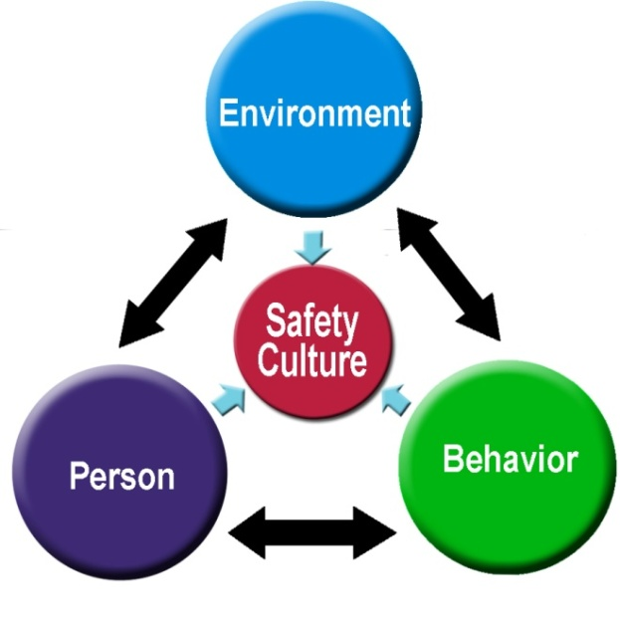
Module 2: Safety Culture and Management Practices
Understand how various safety culture components can be used to implement and maintain a successful FMP
Introduction to safety culture
Corporate responsibilities and roles in FMP implementation
Strategies for engaging and empowering staff and generating commitment in the FMP
Overview of organizational culture change
Performance measures to gauge effectiveness of the FMP
Notes:
Narration:
“Module 2 is designed to introduce the topic of safety culture and management practices related to the FMP to carrier executives and managers. Its goal is to have carrier management understand how various safety culture components can be used to implement and maintain a successful FMP. Included in this module is an introduction to safety culture and principles associated with successful safety cultures. The module then outlines corporate responsibilities and roles in the implementation of the FMP and strategies used to engage and empower staff to generate a sustainable commitment in the FMP. Finally, this module provides an overview of the process of organizational culture change and examples of performance measures necessary to gauge the effectiveness of the FMP.”

Slide 23
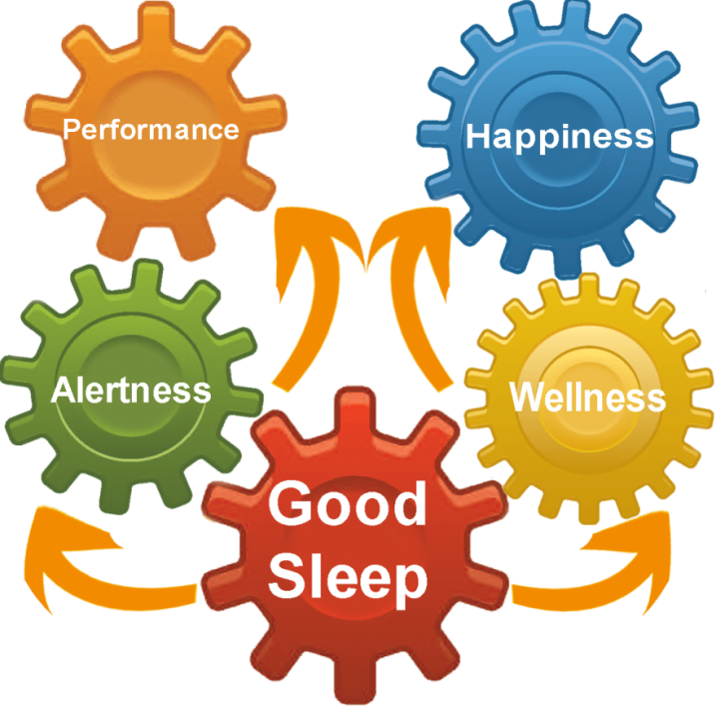
Module 3: Driver Education
Introduction to fatigue/drowsiness
Sleep, alertness, and wellness
Introduction to sleep disorders
Critical fatigue management knowledge, skills, and attitudes
Hours-of-Service (HOS) and scheduling
Notes:
Narration:
“Module 3 is the first module to specifically target drivers. It’s general goal is to teach drivers critical fatigue management concepts and strategies. This module provides drivers with an introduction to fatigue and drowsiness, along with a discussion on the importance of sleep, alertness, and wellness. Also included in this module is an introduction to sleep disorders, strategies for effective fatigue management, and HOS rules.”

Slide 24
Module 4: Driver Family Education
Driver health and wellness
Teach drivers’ families critical driver fatigue management knowledge, skills, and attitudes relevant to home life
Strategies for improving sleep and alertness
Introduction to sleep disorders
Improve home support for driver sleep hygiene
Notes:
Narration:
“Module 4 targets drivers’ families and is designed to improve home support for driver sleep quantity and quality and overall wellness. Drivers’ families are briefly presented with an introduction to sleep disorders and impart various strategies for improving their drivers’ sleep and alertness.”

Slide 25
Module 5: Train-the-Trainer for Driver Education and Family Forum
Prepare carrier management/trainers to teach Modules 3 and 4 and facilitate web-based learning
Introduction to the trainer’s role in the FMP
Trainer activities and responsibilities
FMP training structure and features
Principles and strategies for effective instruction
Notes:
Narration:
“Module 5 is designed for carrier safety managers and driver trainers in the organization. This module’s goal is to prepare trainers to effectively teach Modules 3 and 4. Included in this module is an introduction to the trainer’s role in the success of the FMP, descriptions of activities and responsibilities of the trainer, a review of the FMP training structure and features included in the FMP, and an outline of principles and strategies for effective instruction.”

Slide 26
Module 6: Shipper and Receiver Education
Teach driver fatigue knowledge, skills, and attitudes relevant to shipper/receiver actions
Improve shipper/receiver support for driver rest and HOS compliance
Industry guidelines and standards
“Chain of Responsibility” concept
Shipper and receiver best practices for reducing driver fatigue
Drivers
Fatigue
Management
Carriers
Driver
Families
Shippers &
Receivers
Notes:
Narration:
“Module 6’s goal is to teach shippers and receivers how they can help to reduce driver fatigue by supporting driver rest and HOS compliance. In a sense, the principal strategy of this module is to make shippers and receivers feel that they are “partners” in fatigue management and part of drivers’ “work families.” Shippers and receivers are presented with industry guidelines and standards associated with driver fatigue. This module also outlines the “Chain of Responsibility” concept and implications. Finally, this module provides best practices for reducing driver fatigue that are applicable to shippers and receivers, such as, parking availability and access.”

Slide 27
Module 7: Motor Carrier Sleep Disorders Management
Introduction to sleep disorders, including obstructive sleep apnea (OSA)
Prevention and treatment of OSA
Corporate responsibility and roles in identifying, treating, and managing sleep disorders
Developing and implementing a sleep disorders management program
Strategies for providing driver support and encouragement
Notes:
Narration:
“The goal of Module 7 is to provide education, training, and materials to carrier executives and management so that they may develop and implement a dynamic, innovative, and effective sleep disorders program for their fleet as part of the FMP. This module provides management with an introduction to sleep disorders, including a discussion on the prevention and treatment of OSA. The module also outlines corporate responsibility and roles in identifying, treating, and managing drivers’ sleep disorders, and how management can develop and implement a sleep disorders management program. Finally, the module provides strategies for providing driver support and encouragement.”

Slide 28
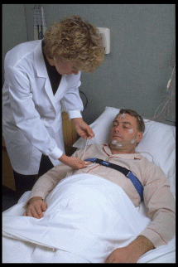
Module 8: Driver Sleep Disorders Management
Inform drivers about sleep disorders, including OSA
Introduction to sleep disorders
Signs, symptoms and implications of OSA
Screening and testing for sleep disorders
Treatment options for OSA
Complying with obstructive OSA treatment
Working with managers for a successful FMP
Notes:
Narration:
“Module 8’s goal is to provide drivers with educational information, materials, and tools concerning sleep disorders, sleep disorders programs in CMV operations, and general recommendations for drivers participating in a fleet-implemented sleep disorders program. This module provides drivers with an introduction to sleep disorders, signs, symptoms, and implications of OSA, and information pertaining to the screening, testing, and treatment for sleep disorders. Drivers are also presented with information about complying with OSA treatment and strategies for working with managers to make the FMP successful.”

Slide 29
Module 9: Driver Scheduling and Tools
Teach best practices to develop and implement a practical, dynamic, and effective driver scheduling program
Introduction to fatigue and its effects
Scheduling factors that drive fatigue
Limitations of current work/rest regulations
Shared responsibility in minimizing fatigue in schedules
Scheduling and tools
Scheduling challenges/case studies
Fatigue Management
Regulators
Scheduling and Management
Drivers
Notes:
Narration:
“Module 9 is designed to provide dispatchers and managers with best practices to develop and implement a practical, dynamic, and effective driver scheduling program. This module is also considered an advanced module for drivers if they have interest in completing it. This module begins with a brief introduction to fatigue and its effect on CMV drivers. Dispatchers then receive information on how driver scheduling impacts fatigue, the limitations of current work/rest regulations, and why there is a shared responsibility for minimizing fatigue in schedules. Finally, Module 9 outlines strategies for implementing scheduling tools, challenges faced when scheduling drivers, and case studies detailing best practices.”

Slide 30
Module 10: Fatigue Monitoring and Management Technologies
Educate management on fatigue management technologies (FMT) and their successful selection and integration in a fleet FMP
Introduction to FMTs
Back-office level FMTs vs. driver-level FMTs
Concepts of FMTs
Current FMTs
Deployment considerations
Operational guidelines
New technologies evaluation
Back Office Level
Driver Level
Vehicle Kinematics
&
Driver Input
Driver Physiological Measures
&
Psychomotor Skills
Non-driver measures
Both Levels
Notes:
Narration:
“The final module is designed to educate carrier executives, transportation directors, and safety managers so that they better understand how fatigue monitoring and management technologies, also known as FMTs, can be used as part of an overall FMP. This module provides management with an introduction to FMTs, a description and concepts of back-office FMTs and driver-level FMTs, and current FMTs available on the market. Also included in this module are deployment strategies and operational guidelines for implementing FMTs. Finally, a guide to evaluating new FMTs is presented.”

Slide 31
Instructional Modules
Module | Title | Target Audience | Estimated Duration
1 | FMP Introduction and Overview | Carrier Executives and Managers | 45 minutes
2 | Safety Culture and Management Practices | Carrier Executives and Managers | 1.5 hours
3 | Driver Education | Drivers | 3 hours
4 | Driver Family Education | Drivers’ Spouses and Family | 45 minutes
5 | Train-the-Trainer for Driver Education and Family Forum | Carrier Safety Managers and other Trainers | 3.5 hours
6 | Shippers and Receivers | Shippers and Receivers | 30 minutes
7 | Motor Carrier Sleep Disorders Management | Carrier Executives and Managers | 1.5 hours
8 | Driver Sleep Disorders Management | Drivers | 1.25 hours
9 | Driver Scheduling and Tools | Dispatchers and Managers * | 1 hour
10 | Fatigue Monitoring and Management Technologies | Carrier Executives and Managers | 1 hour
Notes:
Narration:
“As a review, this is a comprehensive approach to reduce driver fatigue and its implications. Modules have been developed to target all parties that contribute to driver fatigue, including: drivers, carrier management, drivers’ families, dispatchers, and shippers and receivers. Completion of the FMP will increase the awareness of driver fatigue while effectively reducing the outcomes associated with it.”
______________________________________
*Module 9 is an advanced module for drivers if interested

