Slide 1
Module 3: Driver Education
Notes:
Complete Narration: “This is North American Fatigue Management Program Module 3, Driver Education.”
_______________

Slide 2
Introduction
Notes:
Complete Narration: “We’ll begin with an introduction to the module and the Fatigue Management Program (or FMP). We’ll also cover some basics of alertness, sleep, wellness, and performance.”

Slide 3
Introduction to Module
Topics:
North American Fatigue Management Program (NAFMP)
NAFMP training program
Module overview
Learning goals
Notes:
Complete Narration: “Our introduction includes an overview of the North American Fatigue Management Program, the NAFMP training program, this module, and its learning goals.”
_______
Additional instructor note:
Learning objectives for this section include:
(K) Recognize NAFMP purpose.
(K) Recognize this module as part of a 10-module NAFMP training program.
(K) Understand general organization of module and major sections.
(K) Recognize general module learning goals (Knowledge, Skill, Attitudes)
(K) Recognize seven acronyms used in module.

Slide 4

North American Fatigue
Management Program (NAFMP)
Reality: Hours-of-Service (HOS) compliance is essential
Needed: A more proactive and comprehensive approach, centered around drivers
Notes:
Complete Narration:“If you have been a CMV driver for a while, you probably already know this reality: Hours-of-Service compliance, for both the daily and weekly requirements, is essential for rest/sleep. However a more proactive and comprehensive approach will support drivers in further managing other risk factors that contribute to fatigue. That’s why the North American Fatigue Management Program has been developed.”
_____
Additional comment: The NAFMP and this module are supportive of HOS rules and their importance. At the same time, they try to educate drivers and managers about the need for more comprehensive fatigue management.

Slide 5
NAFMP Training Program
Module | Audience
Module 1: FMP Introduction and Overview | Carrier Execs & Managers
Module 2: Safety Culture and Management Practices | Carrier Execs & Managers
Module 3: Driver Education | Drivers
Module 4: Driver Family Education | Driver Families
Module 5: Train-the-Trainer for Driver Education and Family Forum | Managers & Other Trainers
Module 6: Shippers and Receivers | Shippers & Receivers
Module 7: Motor Carrier Management Sleep Disorders Screening and Treatment | Carrier Execs & Managers
Module 8: Driver Sleep Disorders Screening and Treatment | Drivers
Module 9: Driver Scheduling and Tools | Dispatchers & Managers
Module 10: Fatigue Management Technologies | Carrier Execs & Managers
Notes:
Complete Narration: “The NAFMP training program consists of 10 modules, some written for different audiences. This module and one other, Module 8, are primarily for drivers.”
________
Additional information: At a minimum, trainers should take Modules 1, 3, and 4, and then complete Module 5 (Train-the-Trainer).

Slide 6
Module 3 Overview
Introduction Introduction to Module Sleep, Alertness, Wellness, & Performance Lesson 1: Characteristics of Fatigue & Fatigue Crashes What is Fatigue? Fatigue Characteristics Fatigue-Related Crashes | Lesson 2: Sleep & Other Factors Affecting Alertness What is Sleep? Factors Affecting Alertness & Performance Individual Differences in Fatigue Susceptibility Lesson 3: Health, Wellness, Drugs, & Medications Health & Wellness Drugs & Medications | Lesson 4: Alertness & CMV Driving Improving Sleep & Alertness Scheduling & HOS Team Driving Conclusion Review Module Exam
Notes:
Complete Narration: “Here is an overview of the lessons and topics of this Driver Education module. There is this introduction, four lessons, and a conclusion. Take a moment to review the lessons and topics. Each lesson ends with a short self-test, and the module ends with a 30-item exam.”
____________
Additional instructor note: It is suggested that you “walk through” the lessons and topics to give students an advance overview.

Slide 7

Module 3 Driver Education
Learning Goals
Knowledge: Know major facts and principles of driver fatigue, alertness, sleep, & wellness.
Skills: Apply this knowledge to better manage demands of your work and life.
Attitudes: Value sleep, alertness, and wellness as major factors in your driving performance, safety, and happiness.
Notes:
Complete Narration: “Your learning goals for this module include knowledge, skills, and attitudes. You may have heard them called “KSAs.” Your knowledge goal is to know the major facts and principles of driver fatigue, alertness, sleep, and wellness. Your skill goal is to apply this knowledge to better manage the demands of your work and life. And, in regard to attitudes, we hope you will come to value sleep, alertness, and wellness as major factors in your driving performance, safety, and happiness.”

Slide 8

Acronyms
FMP = Fatigue Management Program
NAFMP = North American FMP
CMV = Commercial Motor Vehicle
REM = Rapid Eye Movement
OSA = Obstructive Sleep Apnea
BMI = Body Mass Index
HOS = Hours of Service
Notes:
Complete Narration: “Here are some of the acronyms we will be using in this module. You may not be familiar with all of these, but you will be by the time you complete the instruction. Take a moment to review them.”

Slide 9
Sleep, Alertness, Wellness,
& Performance
Topics:
Importance for CMV driver health & safety
What is alertness? What is wellness?
Good sleep: the key
Sleep hygiene & self-management
Notes:
Complete Narration: “Our introduction continues with some basics on alertness, sleep, wellness, and driving performance. We’ll discuss their importance for health and safety. We’ll define alertness and wellness, and show how they are the benefits of good sleep. Finally, we’ll discuss sleep hygiene, which is self-management from the sleep and health perspective.”
_______
Additional instructor note:
Learning objectives for this section include:
(K) Recognize facts relating to the importance of sleep, alertness, and wellness for CMV drivers
(K) Recognize definitions of alertness, wellness, and sleep hygiene.
(K) Recognize relationships among sleep, alertness, performance, wellness, and happiness.
(A) Value the personal and safety benefits of sleep, alertness, and wellness.
(A) Accept personal responsibility to self-manage alertness.
Additional comment: The concepts presented in this section are general and intended to help establish driver appreciation of the importance of fatigue management, before proceeding to more substantive content.

Slide 10

Importance to Health
Sleep is a biological need
Poor sleep contributes to:
  Cardiac conditions
  Diabetes
  Obesity
  Psychological disorders
  Other medical conditions.
Good sleep promotes wellness, high performance, and happiness
Notes:
Complete Narration: “Sleep is a biological need, like food and water. Poor sleep contributes to cardiac conditions, diabetes, obesity, psychological disorders, and other medical conditions. Good sleep promotes wellness, high performance, and personal happiness.”
_______
Additional comment: Research in recent years has greatly increased our knowledge of the importance of good sleep for health. The medical conditions listed are just a few of those associated with poor sleep.

Slide 11

Importance to Safety
Falling asleep-at-the-wheel is a top cause of crash deaths for CMV drivers
Medical crises are another major cause of road deaths for drivers
An out-of-control truck or bus is a threat to anyone on our roadways.
One serious at-fault crash can end your career
It can even put a company out-of-business
Notes:
Complete Narration: “Sleep, alertness, and wellness are also important to your safety. Asleep-at-the-wheel crashes are a top cause of death for CMV drivers. Medical crises, which can be associated with poor sleep, are another major cause of road deaths for drivers. An out-of-control truck or bus is a threat to anyone on our roadways. One serious at-fault crash can end your driving career, and it can even put a company out-of-business.”
_______
Additional information: Statement about asleep-at-the-wheel crashes is based on National Transportation Safety Board (NTSB), 1990 (to be discussed later in this module).

Slide 12

Alertness, Wellness, & Sleep
What is alertness?
Alert = awake + attentive
What is wellness?
Wellness = physical, mental, emotional, & behavioral health and well-being
Good sleep is essential for both alertness and wellness.
Notes:
Complete Narration: “So what is alertness? Being “alert” means you are awake and attentive. What is wellness?
Wellness is physical, mental, emotional, and behavioral health and well-being. Good sleep is essential for both alertness and wellness.”

Slide 13
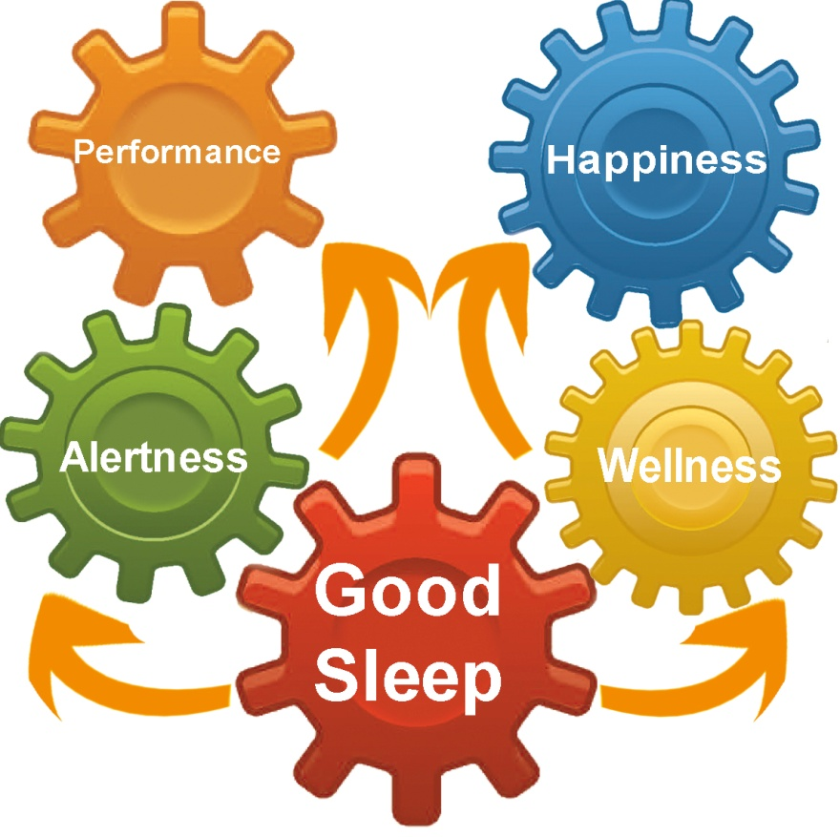
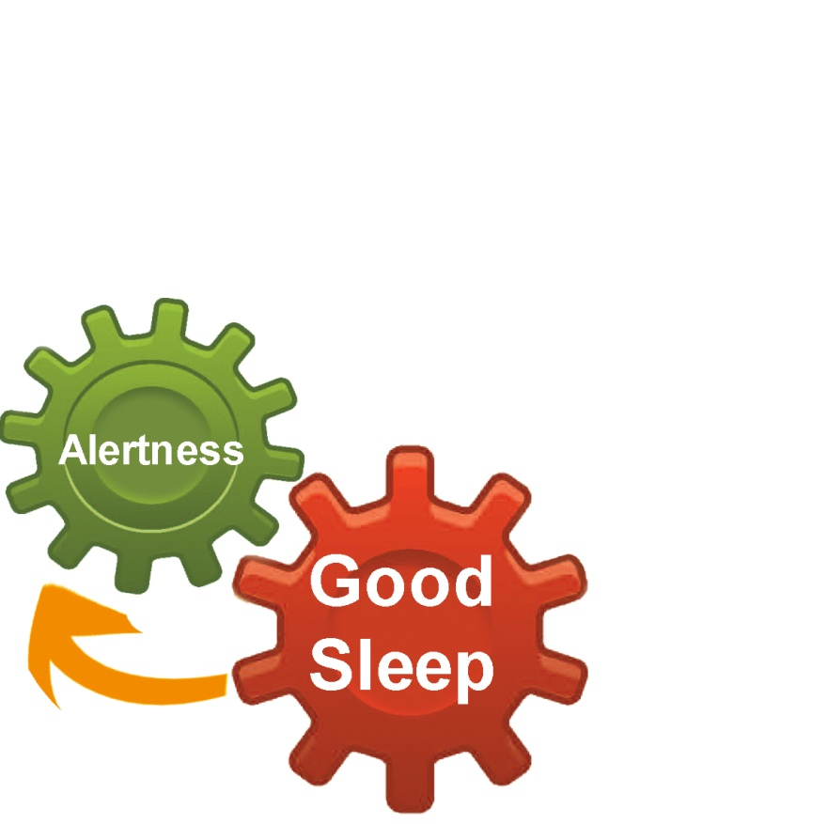
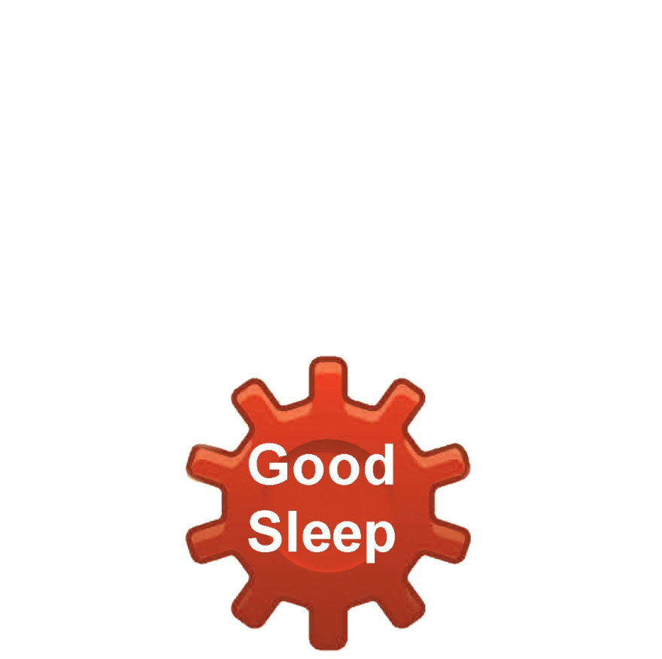
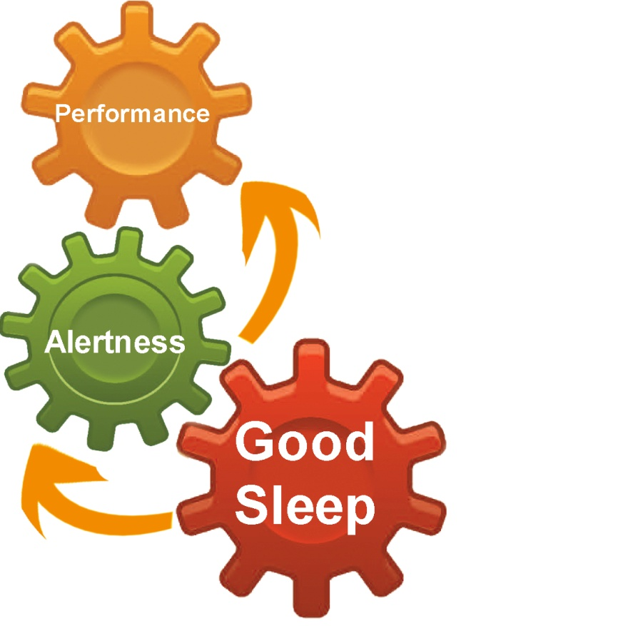
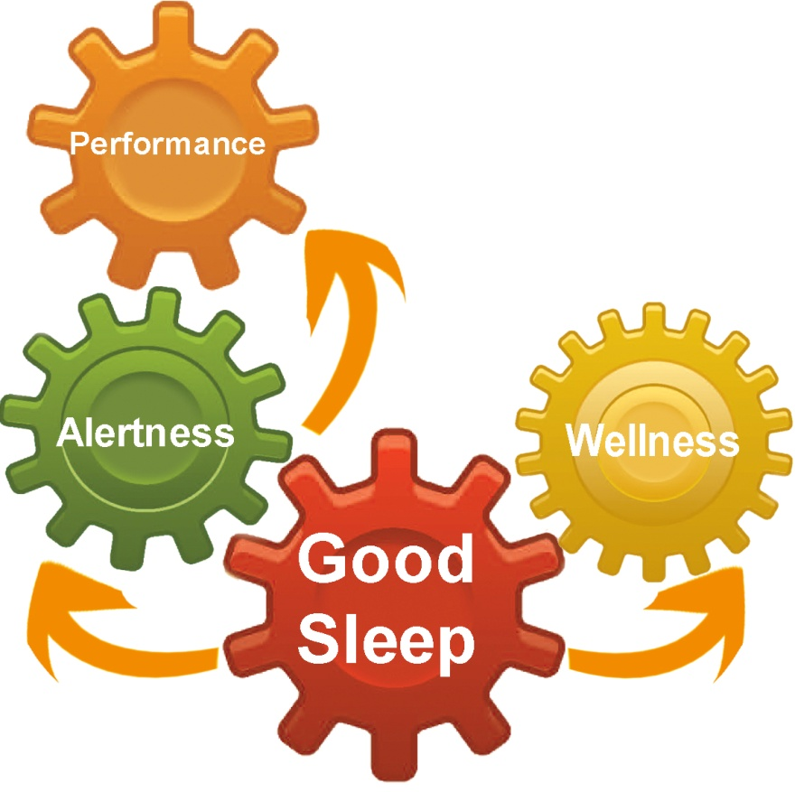
Good Sleep: A Key to
Performance & Happiness
Notes:
Complete Narration:
“It all starts with good sleep.
[add arrow & Alertness] Good sleep is essential for alertness . .
[add arrow & Performance] and alertness makes good performance possible.
[add arrow & Wellness] Good sleep is also essential for wellness . . .
[add arrow & Happiness] and wellness is a big ingredient in personal happiness. That makes sleep one of the most important things in your life.”
_______
Additional comment: Research has proven the links between good sleep and alertness, performance, and wellness. The link to happiness is more subjective, but most people would agree that happiness is in part the result of having good health and being able to perform well.

Slide 14

A Challenge & Responsibility
CMV driving is a challenging
job under often-difficult
conditions.
Each driver has a personal responsibility to wisely manage his or her own sleep, health, and lifestyle.
Sleep hygiene ≈ self-management.
Notes:
Complete Narration: “Getting good sleep is not easy. It is a challenge and responsibility you face. CMV driving is a challenging
job under often-difficult conditions. Each driver has a personal responsibility to wisely manage his or her own sleep, health, and lifestyle. We call that sleep hygiene and it is all about self-management. Part of being a professional driver is self-management, just as you manage your vehicle, your road speed, and the space around your vehicle as you drive.
This ends our Introduction; let’s go on to the first lesson.”
_______
Additional comment: The terms “sleep hygiene” and “fatigue management” are almost synonymous. “Sleep hygiene” is used here more in the context of personal lifestyle, whereas “fatigue management” is used more in the context of transport operations. Both primarily involve behavioral self-management.

Slide 15
Lesson 1: Characteristics of
Fatigue & Fatigue Crashes
Notes:
Complete Narration: “Lesson 1 of our module covers the characteristics of fatigue and fatigue crashes. Topics include, “What is Fatigue?,” Fatigue Characteristics, and Fatigue Crashes.“

Slide 16
What is Fatigue?
Topics:
Fatigue elements/aspects
Two categories of fatigue:
  Internal
  Task-related
How fatigue progresses
Sleep as the principal antidote to fatigue
Notes:
Complete Narration: “The topic, “What is Fatigue?” includes fatigue elements and aspects, two categories of fatigue (internal & task-related), how fatigue progresses, and sleep as the principal antidote to fatigue.”

Slide 17

Fatigue involves . . .
Decreased alertness
Decreased attention to the environment (vigilance)
Reduced performance
Reduced motivation
Irritability
Impaired judgment
Feelings of drowsiness
Notes:
Complete Narration: “Fatigue involves decreased alertness, decreased attention to the environment (also termed vigilance), reduced performance, reduced motivation, irritability, impaired judgment, and, usually, feelings of drowsiness. Driving fatigue is not the same as muscular fatigue. For example, loading or unloading a truck generally does not impair your subsequent driving, even though you may be physically tired.””

Slide 18
Internal vs. Task-Related Fatigue
Two general categories of fatigue:
  Internal fatigue
  (sleep-related)
  Task-related fatigue
  (activity-related)
Both can affect your performance even if you don’t fall asleep-at-the-wheel
Reduced vigilance begins well before feelings of sleepiness
Notes:
Complete Narration: “Two general categories of fatigue are internal fatigue, also called “sleep-related” fatigue, and task-related fatigue, also called activity-related fatigue. Both can impair your performance even if you don’t fall asleep-at-the-wheel. Reduced vigilance – that is, reduced attention to the environment – begins well before feelings of sleepiness.”

Slide 19
Internal vs. Task-Related Fatigue
Internal Factors
Individual Susceptibility
Amount of Sleep
Time-of-Day
Time Awake
Stimulants, Other Drugs
Health
Mood
Task-Related Factors
Time-on-Task
Task Complexity
Task Monotony
ALERTNESS
ATTENTION
DRIVING PERFORMANCE
Notes:
Complete Narration: “Let’s show how internal and task-related fatigue factors combine to affect alertness, attention, and driving performance.
[Insert Internal factors box] Internal factors include individual susceptibility; amount of sleep; time-of-day; time awake; stimulants like caffeine, and other drugs; your general health; and your mood.
(Insert Task-related box] Task-related factors include time-on-task (such as hours of driving), task complexity, and task monotony.
[Insert two arrows and Alertness] All these factors affect your level of alertness . . .
[Insert arrow and Attention] . . . which in turn affects your attention to the environment.
[Insert arrow and Driving Performance] That affects your driving performance.”
________________________
Additional information: Figure adapted from Thiffault (2011).

Slide 20
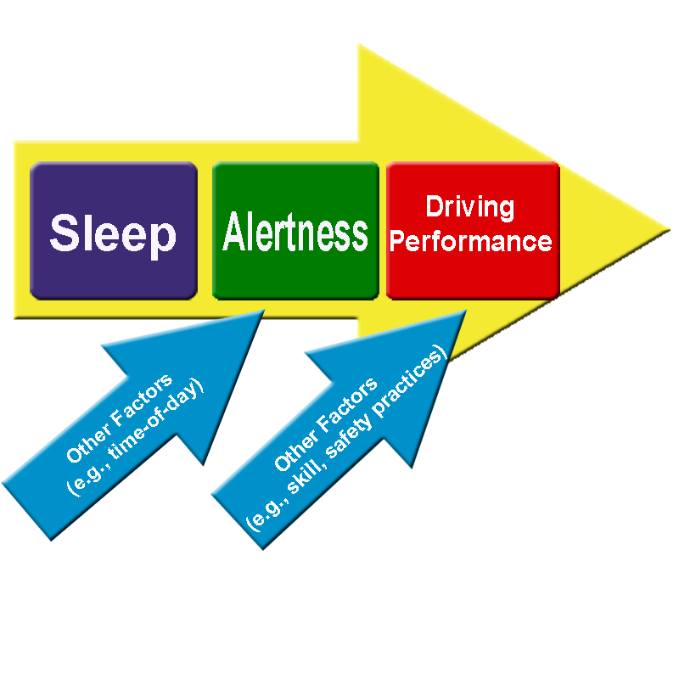
SLEEP
The Most Important Antidote to Fatigue
Notes:
Complete Narration: “While the science of driver fatigue can be complicated, it can also be pretty simple. Sleep is the most important antidote to fatigue. Sleep and other factors, such as time-of-day, determine your level of alertness. Your alertness, along with other factors, affects your driving performance. If you want to perform at a high level, start with good sleep.

Slide 21
Fatigue Characteristics
Topics:
Acute vs. chronic
Signs and symptoms
Subjective vs. objective self-assessments
Health effects of sleep deprivation
Signs of chronic sleep deprivation
Sleep debts and recovery
Notes:
Complete Narration: “Let’s talk about the characteristics of fatigue. Topics include acute (or short-term) fatigue versus chronic fatigue, general signs and symptoms of fatigue, subjective versus objective self-assessments, effects of sleep deprivation on your health, signs of chronic sleep deprivation, and sleep debts and recovery.”

Slide 22
Acute vs. Chronic Fatigue
Acute (short-term) fatigue:
  Experienced every day
  Reduced or eliminated by a night’s sleep or nap
  Caffeine and rest (without sleep) reduce mild fatigue
Chronic (long-term) fatigue:
  Afflicts many drivers and other busy people
  Due to inadequate sleep over a longer period
  Called sleep deprivation
  To recover, need a few nights of long, sound sleep
Notes:
Complete Narration: “We’ll start with the distinction between acute and chronic fatigue. Acute or short-term fatigue is what we experience every day. It is reduced or eliminated by a night’s sleep or a nap. Caffeine and rest (without sleep) reduce mild fatigue. Chronic, or long-term, fatigue afflicts many drivers and other busy people. It is due to inadequate sleep over a longer period, and is also called sleep deprivation. To recover, you need a few nights of long, sound sleep. And maybe you need to make permanent changes to your lifestyle. Chronic fatigue will return if your old habits return.”

Slide 23

Fatigue Signs & Symptoms (1 of 2)
Loss of alertness and attention
Wandering thoughts
Poor response, slow reactions
Distorted judgment
Loss of motivation
Notes:
Complete Narration: “Whether fatigue is acute or chronic, there are certain signs and symptoms. They include loss of alertness and attention, wandering thoughts, poor response with slow reactions, distorted judgment, and loss of motivation.”

Slide 24
Fatigue Signs & Symptoms (2 of 2)
Depression
Impaired memory
Reduced field-of-vision
(“tunnel vision”)
Microsleeps
Little effect on purely
physical tasks
Notes:
Complete Narration: “Additional signs and symptoms of fatigue include depression, impaired memory, reduced field-of-vision or “tunnel vision”, and microsleeps. Microsleeps are short losses of consciousness. You “nod off” for a few seconds. Microsleeps become longer, more frequent, and more dangerous with greater fatigue. . . . Note, however, that fatigue has little effect on purely physical tasks such as walking or lifting.”

Slide 25
Subjective vs. Objective Assessments
Driver Fatigue and Alertness Study:
Drivers subjectively rated their own alertness
Self-ratings were often inaccurate compared to objective measures
Drivers tended to rate themselves as more alert than they actually were
Self-ratings tended to be based on expectations:
  “I’ve been driving for a long time, so I must be tired”
  “I just started driving, so I couldn’t be tired”
Notes:
Complete Narration: “Let’s talk about subjective versus objective assessments of fatigue. In the U.S./Canada Driver Fatigue and Alertness Study, drivers subjectively rated their own alertness. Self-ratings were often inaccurate compared to objective measures of alertness. Drivers tended to rate themselves as being more alert than they actually were. Self-ratings tended to be based on expectations. A person might say, for example, “I’ve been driving for a long time, so I must be tired.” Or, “I just started driving, so I couldn’t be tired.”
________
Study cited: Driver Fatigue and Alertness Study, Wylie et al., 1996. Also see Wylie et al., 1997.
Additional information: The fact that drivers tend to rate themselves as more alert than they actually are is an example of the self-assessment bias in driving. One study showed that about half of all U.S. drivers consider themselves to be in the top 20%!

Slide 26
Will you fall asleep in the next 2 minutes?
Stanford University Study:
Subjects sleep-deprived and asked to stay awake as long as possible
Periodically asked to predict whether they would fall asleep in the next 2 minutes
Onset of sleep correctly predicted 78% of the time
But 22% of the time it wasn’t
Large individual differences in ability to predict falling asleep
Notes:
Complete Narration: “Stanford University conducted a study in which subjects were sleep-deprived and asked to stay awake as long as possible. They were periodically asked to predict whether they would fall asleep in the next 2 minutes. The onset of sleep was correctly predicted 78% of the time by the subjects. But 22% of the time it wasn’t. This would be like thinking you could stay awake but then fall asleep-at-the-wheel. There were large individual differences in the ability to predict falling asleep. Some people predicted so poorly it was almost like guessing. You don’t want to be driving down the road guessing whether you will stay awake or fall asleep!”
______________________
Source: Itoi et al., 1993.

Slide 27
Many Asleep-at-the-Wheel Drivers Never Feel Drowsy!
University of North Carolina Study:
Interviews with 312 motorists who had crashed after falling asleep at the wheel
Question: “How drowsy did you feel before you fell asleep at the wheel?”
Notes:
Complete Narration: “Many asleep-at-the-wheel drivers never feel drowsy! The University of North Carolina conducted interviews with 312 motorists who had crashed after falling asleep-at-the-wheel. They were asked “How drowsy did you feel before you fell asleep-at-the-wheel?” As you see in this pie-chart, 23% said that they were “not at all drowsy.” Another 21% said only, “slightly drowsy.” These people never expected to fall asleep at the wheel.”
__________________
Source: Stutts et al., 1999.

Slide 28
But Only 11% Had 8+ Hours Sleep the Night Before!
Question: “How much sleep had you had the night before?”
8+ Hours
Notes:
Complete Narration: “But, in the same study, only 11% of the people had had 8 or more hours of sleep the night before. They were asked, “How much sleep had you had the night before the crash?” Only 11% had had 8 or more hours, while another 28% had had 6 to 7.9 hours. A total of 54% had had less than 6 hours sleep. Sleep loss is the major cause of fatigue-related crashes.”
_____________________________
Additional information: As previously, University of North Carolina Study: Interviews with 312 motorists who had crashed after falling asleep-at-the-wheel.
Source: Stutts et al., 1999.

Slide 29

Objective Signs of Sleepiness While Driving (1 of 2)
Eyes:
  Eyelid droop
  Loss of focus
Yawning
Thoughts:
  Wandering, disjointed
  Scattered, dreamlike visions
Head movements:
  Gentle swaying
  Jerks
Reduced field-of-view (“tunnel vision”)
Notes:
Complete Narration: “Try to assess your own fatigue based on objective signs. These include eyelid droop and loss of focus; yawning; wandering and disjointed thoughts; scattered, dreamlike visions; head movements such as gentle swaying or jerks; and reduced field-of-view, or “tunnel vision.” An example of tunnel vision would be failing to check your mirrors.”

Slide 30
Objective Signs of Sleepiness While Driving (2 of 2)
Body movements:
  Fidgeting, shifting positions
  Adjusting windows, HVAC
Vehicle control:
  Weaving (progressive)
  Crossing rumble strip
  “Drift and jerk” steering
  Variable Speed
Delayed or incorrect responses
Microsleeps
Notes:
Complete Narration: “Other objective, observable signs of sleepiness include body movements like fidgeting, shifting positions, adjusting windows or the air conditioning. Vehicle control may also decline as seen in weaving, crossing a rumble strip, “drift & jerk” steering, and driving at variable speeds. Other signs include delayed or incorrect responses and microsleeps.”
________
TtT Narration: “Other objective, observable signs include those related to body movements and vehicle control. Fatigued drivers may also make delayed or incorrect responses, or have microsleeps.”
Additional information: In a microsleep, the brain transiently goes into light sleep, even though the eyes may still be open. It is like a camera with no film. Information is coming in but it is not registering.

Slide 31
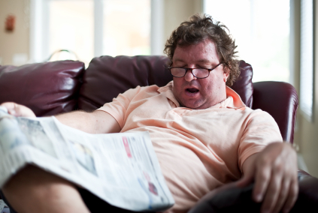
Health Effects of Sleep Deprivation (1 of 2)
Increased blood pressure
Increased risk of heart disease
Gastrointestinal problems
Increased sick days
Increased calorie consumption
Weight gain
Notes:
Complete Narration: “The health effects of sleep deprivation are less immediate but equally frightening. They include increased blood pressure, increased risk of heart disease, gastrointestinal problems, increased sick days, increased calorie consumption, and weight gain.”
________
Principal source: Saltzman and Belzer, 2007.

Slide 32
Health Effects of Sleep Deprivation
(2 of 2)
Increased diabetes risk
Reduced immune system functioning
Irritability
Disrupts relationships
Worsens psychiatric conditions
Decreased quality of life
Notes:
Complete Narration: “There is also increased diabetes risk, reduced immune system functioning, irritability, disruption of relationships, worsened psychiatric conditions, and decreased quality of life.”
___________________
Principal source: Saltzman and Belzer, 2007.

Slide 33
Are You Chronically Sleep-Deprived?
Do you fall asleep in 5 minutes or less?
Can you nap almost anywhere, any time?
Do you feel sleepy when you are bored?
Do you fall asleep easily while watching TV or in movies?
Do you ever fall asleep while stopped for traffic lights?
Notes:
Complete Narration: “Are you chronically sleep-deprived? Do you fall asleep in 5 minutes or less? Can you nap almost anywhere, any time? Do you feel sleepy when you are bored? Do you fall asleep easily while watching TV or in movies? Do you ever fall asleep while stopped for traffic lights?”
________
TtT Narration: “These five questions are poised to stimulate self-evaluation by drivers. In classroom instruction, you might ask students to privately write down their answers. While there is no scoring to the self-test, several “yes” answers probably indicates chronic sleep deprivation.”

Slide 34
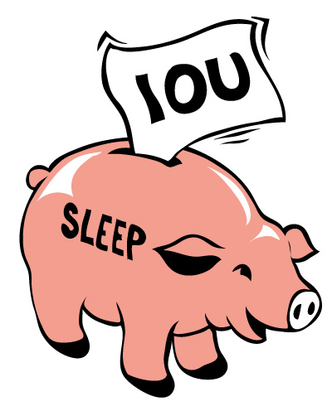
Sleep Debts
If you answered “yes” to the previous questions, you are probably chronically sleep deprived.
In other words, you have a sleep debt.
Like financial debt, you need to start paying it off.
Only one way to pay your debt → SLEEP!
Notes:
Complete Narration: “If you answered “yes” to the previous questions, you are probably chronically sleep deprived. In other words, you have a sleep debt. Like a financial debt, you need to start paying it off. There’s only one way to pay your debt: Sleep! You don’t have to pay back sleep hour-for-hour, but, like paying off other debts, it may take some time.”

Slide 35

Recovery from Sleep Deprivation
Begins following one night of good sleep.
May not be complete until you have several nights of good sleep.
Solution:
  Don’t get sleep deprived to begin with.
  Whenever possible, sleep until you wake up.
  Get more than one good night’s sleep on weekends.
To some extent, extra sleep can be “banked.”
Notes:
Complete Narration: “First, the good news: Recovery begins following one night of good sleep. However, recovery may not be complete until you have several nights of good sleep. The real solution involves lifestyle changes. Don’t get sleep deprived to begin with. Whenever possible, sleep until you wake up – don’t set an alarm clock. And get more than one good night’s sleep on weekends. There’s more good news: To some extent, extra sleep can be “banked.” Getting more sleep on a weekend will help you, to some extent, all week.
_______________________
Additional information: Item on “banking” of extra sleep based on a sleep deprivation study conducted by the Walter Reed Army Institute of Research (Balkin, 2011). Subjects spending 10 hours a night in bed for a week before the sleep deprivation period were more alert than those who just followed their normal routine (7-8 hours in bed) prior to the sleep deprivation period.

Slide 36
Fatigue-Related Crashes
Topics:
Characteristics
Ways fatigue causes crashes
How many fatigue crashes?
  Serious crashes
  Fatal-to-the-driver crashes
  Difficulties in estimating
Notes:
Complete Narration: “Next we’ll discuss fatigue-related crashes, their characteristics, ways that fatigue causes crashes, and the number of fatigue-related crashes.”

Slide 37

Fatigue-Related Crashes
Usually single-vehicle road departures
Driver alone
Often on monotonous roads
Most in early morning, especially 2:00 am to 7:00 am
Usually serious crashes
Notes:
Complete Narration: “What would happen if you closed your eyes for ten seconds while driving? You’d probably drift out of the lane and hit something. That’s the typical fatigue-related crash. They are usually single-vehicle road departures, although you could drift to the left and have a head-on crash. If a truck or bus stays in its lane, a high-speed rear-end crash may occur. Drivers falling asleep are usually alone, often driving on monotonous roads. These types of crashes are most likely to happen in the early morning, especially between 2 and 7 am. Fatigue-related crashes are usually serious. They are at least twice as likely as other crashes to result in injuries or death.”

Slide 38

Principal Cause: Insufficient Sleep
Australian study found that truck drivers with less than
6 hours sleep were:
  3 times more likely to have a hazardous incident
  2.5 times more likely to nod off
Notes:
Complete Narration: “Fatigue-related crashes are usually associated with insufficient sleep prior to the crash. A study in Australia found that truck drivers who had had less than 6 hours sleep were 3 times more likely to have a hazardous incident, and 2.5 times more likely to nod off. HOS regulations give drivers the opportunity to receive adequate rest/sleep”
_____________________
Australian study: Arnold and Hartley, 1998.

Slide 39
24-Hour Relative Rate
Notes:
Complete Narration: “This graph shows estimates of the relative rate of fatal fatigue-related crashes across the 24-hour day. There is a big spike in the early morning hours between 2 and 7am. Notice also a small rise in the rate during the mid-afternoon.”
__________________________
Additional information: Figure shows estimated relative 24-hour fatal fatigue crash rate for large trucks. All days of the week are combined. These are only estimates because they are based in part on estimates of vehicle mileage exposure by hour-of-day. Data are normalized so 24-hour rate = 1.0. Source: Knipling, 2009. In the LTCCS (a different dataset than that presented in this slide), 62% of truck driver asleep-at-the-wheel crashes occurred in the two-hour period between 4:01am and 6:00am.

Slide 40
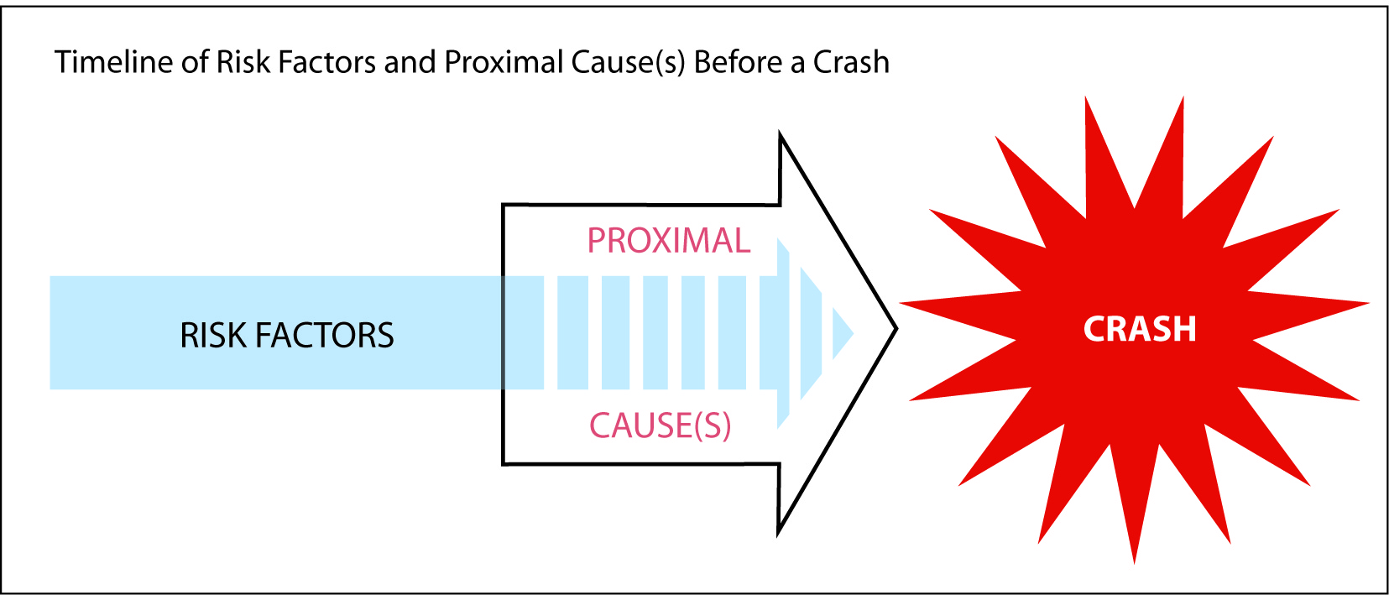
Two General Ways Fatigue Can Cause Crashes
Raise the risk of driving errors
Directly cause a crash (asleep at the wheel)
Timeline leading to a crash
DIRECT
CAUSES
Notes:
Complete Narration: “There are two general ways that fatigue can lead to crashes. First, it can raise the risk of driving errors. For example, you may fail to see an oncoming vehicle when making a left turn. Secondly, fatigue can directly cause a crash if you fall asleep at the wheel. The schematic shows a timeline leading to a crash. Risk factors like fatigue exist prior to the crash. And, usually there is also an immediate and direct crash cause, such as falling asleep or some other failure of the driver.”
_____________________________
Graphic from Safety for the Long Haul; Large Truck Crash Risk, Causation, & Prevention (Knipling, 2009). Used with permission.

Slide 41
How Many CMV Crashes are Fatigue-Related?
Large Truck Crash Causation Study (LTCCS):
In-depth investigations of ~1,000 serious large truck crashes
4% of truck crash involvements caused principally by truck driver asleep at the wheel
A larger number (13%) involved truck driver fatigue as an associated factor
Other crashes could have involved undetected fatigue
Notes:
Complete Narration: “How many CMV crashes are fatigue-related? The U.S. DOT Large Truck Crash Causation Study conducted in-depth investigations of about 1,000 serious large truck crashes. These were crashes resulting in an injury or fatality. About 4% of crash involvements were caused by the truck driver falling asleep at the wheel. A larger number (13%) involved truck driver fatigue as an associated factor. Other crashes could have involved undetected fatigue.”
________
TtT Narration: “How many CMV crashes are fatigue-related? There is no single answer, but the LTCCS has provided meaningful estimates. It investigated large truck crashes resulting in serious injuries or fatalities. 4% were directly caused by truck driver asleep-at-the-wheel. But a larger number, 13%, involved fatigue as an associated factor. Many other crashes could involve undetected fatigue, although, by definition, these cannot be documented.”
Additional information: Police-reported statistics (including Police Accident Report-based databases like the General Estimates System (GES) and Fatality Analysis Reporting System (FARS) are generally underestimates because they are relatively superficial investigations. Source, Knipling, 2009; Starnes, 2006.

Slide 42

Fatal-to-the-Driver Truck Crashes
1990 National Transportation Safety Board (NTSB) study of 182 fatal-to-the-driver large truck crashes
Most were single-vehicle road departures
In-depth investigation revealed fatigue to be a principal cause in 31%
Fatigue was the biggest cause
Cardiac and other medical crises are also major causes of such crashes
In 2009, more than 400 U.S. CMV drivers died in crashes
Notes:
Complete Narration: “Fatigue and asleep-at-the-wheel are major causes of crashes in which truck and bus drivers lose their lives. In 1990, the National Transportation Safety Board studied 182 fatal-to-the-driver large truck crashes. Most were single-vehicle road departures. Their in-depth investigations revealed fatigue to be a principal cause of 31% of these crashes. Fatigue was the biggest single cause. More recent crash studies support this finding and suggest also that cardiac and other medical crises are also major causes. In 2009, more than 400 truck and bus drivers died in crashes.”
________
Source: NTSB, 1990. 56 of 182 crashes (31%) had fatigue as a principal factor.
Additional instructor note: The 31% statistic should not be generalized to larger crash populations like “all fatal truck crashes” or “all truck crashes.” Nonetheless, the statistic is important because it shows the importance of fatigue-related crashes for commercial drivers.

Slide 43
Difficulties in Estimating Fatigue-Related Crashes
Driver:
  May be dead or severely injured
  May not know what happened
  May not admit to falling asleep
Fatigue contributes to crashes in subtle ways
Fatigue, distraction, and other causes may look the same
Many factors affect fatigue percentages
Notes:
Complete Narration: “We’ve provided you the best available statistics, but you should realize that it is difficult to estimate the number of fatigue-related crashes. The driver in question may be dead or severely injured, may not know what happened, or may not admit to falling asleep. Also, as we’ve already discussed, fatigue contributes to crashes in subtle ways. Fatigue, distraction, & other causes may look the same. Finally, many factors affect fatigue percentages, so there is no single best estimate.

Slide 44
Lesson 1 Quiz
Which statement is true?
  Sleep is a biological need
  Asleep-at-the-wheel crashes are a major cause of death for CMV drivers
  Poor sleep worsens many medical conditions
  All of the above.
Notes:
Answer: D.

Slide 45
Lesson 1 Quiz
Which would be considered a task-related fatigue factor?
  Driving on a boring road
  Driving during a Circadian valley
  Insufficient prior sleep
  Being awake for 18 hours straight
  All of the above.
Notes:
Answer: A. The others are internal/sleep-related.

Slide 46
Lesson 1 Quiz
Which is not a health effect of sleep deprivation (chronic fatigue)?
  Increased blood pressure
  Decreased appetite
  Increased diabetes risk
  Irritability.
Notes:
Answer: B. Sleep deprivation usually results in increased calorie consumption.

Slide 47
Lesson 1 Quiz
Which is a sign of driver drowsiness?
  Watery eyes and frequent blinking
  Easily distracted (e.g., roadside signs, scenery)
  “Drift-and-jerk” steering, with weaving
  Rigid body position with little movement.
Notes:
Answer: C.

Slide 48
Lesson 1 Quiz
Which statement is not true?
  Fatigue may be a direct crash cause (asleep-at-the-wheel) or a contributing factor.
  The NTSB found asleep-at-the-wheel to be a principal cause of 31% of fatal-to-the-driver truck crashes.
  It is difficult to estimate the exact number of crashes relating to driver fatigue.
  The Large Truck Crash Causation Study (LTCCS) found the majority of crashes to be fatigue-related.
Notes:
Answer: D. In the LTCCS, 13% of truck crash involvements had fatigue as an associated factor. 4% were directly caused by truck driver asleep-at-the-wheel.

Slide 49
Lesson 2: Sleep & Other Factors
Affecting Alertness
Notes:
Complete Narration: “This is Lesson 2 of Driver Education. First, we’ll ask, What is Sleep? Then, we’ll cover factors affecting alertness and performance, and individual differences in fatigue susceptibility.”

Slide 50
What is Sleep?
Topics:
Key features of sleep
Types of sleep and sleep stages
Sleep inertia
Age differences in sleep
Factors affecting sleep quality
Notes:
Complete Narration: “Our discussion of “What is Sleep?” will cover the key features of sleep, types of sleep and sleep stages, sleep inertia (which is the grogginess you feel when you first wake up), age differences in sleep, and factors affecting sleep quality.”

Slide 51

Key Features of Sleep
Sleep is necessary for performance and wellness, but no one knows exactly how or why!
Brain cells grow and connections are made during sleep
Sleep ≠ rest
Sleep is complex - The brain is not simply resting
Notes:
Complete Narration: “What are the key features of sleep? We know that sleep is necessary for performance and wellness, but no one knows exactly how or why! It is known, however, that brain cells grow and connections are made during sleep. Sleep does not equal rest; there’s a big difference between them. We know this from research showing that sleep is complex. The brain is not simply resting.”
___________________________
Additional information: Sleep is studied in sleep labs where people are monitored for EEG (“brain waves”), heart rate, and breathing.

Slide 52
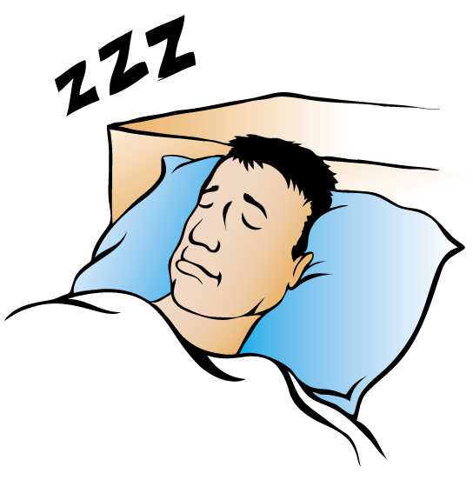
Two Types of Sleep
“Regular” (Non-REM)
  Brain activity reduced but varied
  4 repeating stages of different depths
Rapid Eye Movement (REM)
  Brain active
  Eye movements
  Dreams
  Loss of muscle tone (~paralysis)
Notes:
Complete Narration: “There are actually two different types of sleep. ‘Regular’ or non-REM sleep takes up most of the night. Compared to wakefulness, brain activity is reduced, but varied. There are four repeating stages of different depths. They range from light to deep, and each involves a different level of brain activity. The second type is called Rapid Eye Movement or ‘REM’ sleep. During REM sleep the brain is very active, almost like being awake. Your eyes move, much as they would in actual vision. REM sleep is when you have dreams. You lose your muscle tone during dreams, much like paralysis. REM sleep is like a car in neutral but with its engine racing!”
________
Additional information: “Regular” (non-REM) sleep is known technically as “Slow Wave Sleep.” Each of the four stages has a distinct EEG pattern, but they are less like wakefulness than REM sleep is. Loss of muscle tone occurs in major muscle groups, but not in the muscles that move the eyes.

Slide 53
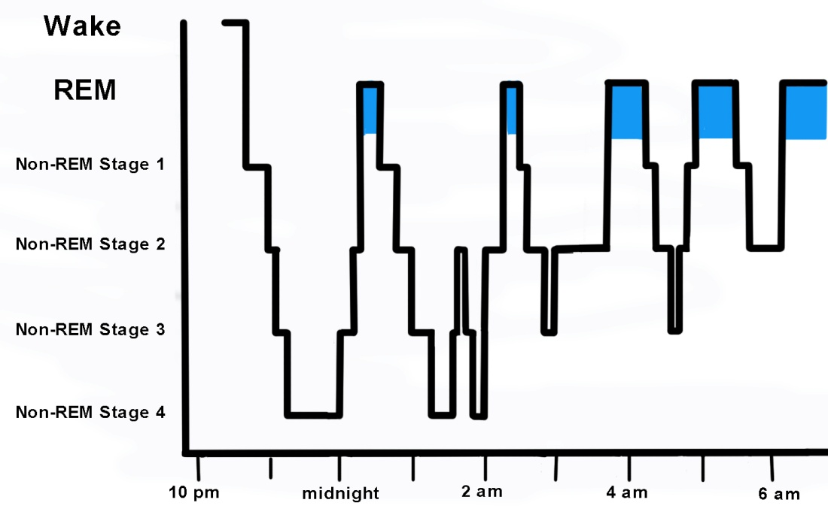
Sleep States & Stages
Notes:
Complete Narration: “This graph shows nightly sleep stages for a healthy young adult. On the left, the vertical axis shows six brain conditions: wakefulness, REM sleep, and Non-REM stages 1, 2, 3, and 4. This person sleeps from about 11pm to 7am. The night starts with a long period of non-REM sleep, with a progression of stages, both down and up. This is repeated through the night, but with the addition of REM periods which are indicated by the colored areas on the graph. As the night progresses, REM periods become more frequent and longer. You see also that, toward morning, the non-REM periods are not as deep.”

Slide 54
Sleep Inertia
Grogginess upon awakening
Can last 20 minutes or more
Can affect driving (especially before daybreak)
Caffeine helps
Notes:
Complete Narration: “Sleep inertia is the grogginess you feel upon awakening, especially from a deep sleep. It can last 20 minutes or more. Sleep inertia can affect your driving, especially if you are getting up before daybreak. Coffee and other caffeinated beverages help to wake you up.”

Slide 55


Age Differences in Sleep
Adults need 7-8 hours
Teenagers and children need more
Older adults:
  Lighter sleep
  More easily disrupted
  May take more naps
  Not more likely to fall asleep at the wheel.
Young males (<30) are highest risk group for asleep-at-the-wheel crashes
But everyone can be at risk!
Notes:
Complete Narration: “Everyone needs sleep and few people get enough. Adults need 7-to-8 hours each day, while teenagers and children need more. Older adults tend to have lighter and more easily disrupted sleep. They may take more naps, but are not more likely to fall asleep at the wheel. Across the general population, young males under 30 are at highest risk for asleep-at-the-wheel crashes. But everyone can be at risk.”
_________________
Additional information: People can survive for extended periods with inadequate sleep, but they cannot sustain maximum performance.

Slide 56
Factors Affecting Sleep Quality
Quantity affects quality
Other factors affecting quality:
  Bed comfort
  Darkness of room
  Time-of-day (best sleep during circadian valleys)
  Noise
  Temperature (cool is best)
  Anything else that might awaken you
Notes:
Complete Narration: “What determines sleep quality? First, quantity affects quality. The more sleep you get, the more likely you will go through all the stages. Other factors affecting the quality of sleep include bed comfort, darkness of the room, time-of-day, noise, temperature (cool is best), and anything else that might awaken you. In regard to time-of-day, sleep is likely to be best during circadian valleys, especially during the overnight and early morning hours.

Slide 57
Factors Affecting Alertness & Performance
Topics:
Review: internal vs. task-related fatigue
Amount of sleep
Time-of-day (circadian rhythms)
Time awake
Time on-task
Other task-related and environmental factors
Task demands and performance
Notes:
Complete Narration: “Next we will review the many factors that affect your alertness and performance. We’ll discuss internal versus task-related fatigue, amount of sleep, time-of-day and circadian rhythms, time awake, time on-task (such as hours of driving), other task-related and environmental factors, and the relation between task demands and performance. Another factor, individual differences in susceptibility, will be presented in the following section.”

Slide 58
Internal vs. Task-Related Fatigue
(1 of 2)
Fatigue Category | General Source | Specific Factors
Internal Fatigue | Body Physiology | Amount of recent sleep Time-of-day Time awake Stimulants/other drugs General health Mood Individual differences in susceptibility
Task-Related Fatigue | Task (Driving, Other Work) | Time-on-task (e.g., hours driving) Task complexity Task monotony
Notes:
Complete Narration: “Earlier we introduced a distinction between internal and task-related fatigue. Internal fatigue is related to body physiology, including the physiology of the brain. Specific factors include amount of recent sleep, time-of-day, time awake, stimulants and other drugs, your general health, moods, and individual differences in susceptibility. Individual differences in susceptibility are caused in part by sleep disorders.”
______________________

Slide 59
Internal vs. Task-Related Fatigue
(2 of 2)
Fatigue Category | General Source | Specific Factors
Internal Fatigue | Body Physiology | Amount of recent sleep Time-of-day Time awake Stimulants/other drugs General health Mood Individual differences in susceptibility
Task-Related Fatigue | Task (Driving, Other Work) | Time-on-task (e.g., hours driving) Task complexity Task monotony
Notes:
Complete Narration: “Less powerful, but still important, is task-related fatigue. Task-related fatigue is related to what you are doing, and how long you have been doing it. Specific factors include time-on-task (such as hours driving), task complexity, and task monotony. All of these internal and task-related factors can interact to affect overall alertness and fatigue. For example, if you haven’t had enough sleep, driving long hours will affect you even more.”

Slide 60
Amount of Sleep
Last main sleep period
(e.g., last night)
Previous sleep periods
(e.g., the nights before; even previous weekend)
Naps
Notes:
Complete Narration: “Sleep is the primary countermeasure to fatigue. Most important is the amount of sleep in your last main sleep period which, for most people, means last night. Previous sleep periods, including the nights before and even the previous weekend, also affect your current alertness. And naps can really give you an alertness boost.”
_______
Additional instructor note: Subsequent slides will provide more detail on the first and last bullets. In regard to previous sleep periods, recall what we learned earlier about sleep debts and recovery.

Slide 61
Cumulative, Progressive Effects of Different Amounts of Sleep on Performance
Notes:
Complete Narration: “This graph shows the cumulative, progressive effects of different amounts of sleep on performance. This sleep deprivation study was conducted using volunteer CMV drivers who agreed to live in a sleep lab for nearly two weeks. This graph shows relative performance on an alertness task over 8 days of restricted sleep. There were four groups. The top, blue line shows those who spent 9 hours in bed each night. As you can see, their performance remained steady and high across the 8 days. The pink line shows those permitted 7 hours in bed. They did pretty well, though you see a small decline over the 8 days. The next line shows those given 5 hours in bed; their performance showed a steady decline. Now look at the red line showing performance deterioration among drivers given only 3 hours in bed each night. Their performance declined dramatically. Notice that all the differences are progressive; that is, they get bigger and more pronounced with each passing day. If you drive for a week getting insufficient sleep every night, your performance will progressively decline, just as you see in this graph.”
_______
Cited source: Balkin et al., 2000. This is a good example of a partial sleep deprivation study, where all subjects get some sleep but some get less than they need. Other studies show that any sleep in such studies is much better than no sleep. Performance measure was the Psychomotor Vigilance Test (PVT), a measure of visual attention which is frequently used in studies of alertness and fatigue. This work was conducted at the Walter Reed Army Institute of Research with commercial drivers as subjects.
Additional instructor note: Not everyone is used to interpreting graphs, so this slide may be difficult for some participants. Make sure they understand its key implications regarding the progressive effects of repeated sleep loss. As sleep deprivation (whether mild or severe) continues, sleep debts continue to grow and performance becomes worse.

Slide 62

Naps
Best on-the road countermeasure to drowsiness!
Can greatly improve alertness and performance for hours afterwards
NASA study of airline pilots: Planned naps reduced subsequent dozing by 50% and errors by 34%
Optimal nap duration: 20-40 minutes
Two cautions:
  Grogginess (sleep inertia) following naps, especially longer ones
  Possible disruption of sleep in next main sleep period, also especially for longer naps
Notes:
Complete Narration: “Ever hear the phrase “power nap.” Well, naps really are powerful! They are the best on-the road countermeasure to drowsiness! Even a short, 20-minute nap can greatly improve alertness and performance for hours afterwards. NASA conducted a study of airline pilots flying across the Pacific. They found that planned naps reduced subsequent dozing by 50% and landing errors by 34%. Unless you have a significant sleep debt, the optimal nap duration is 20 to 40 minutes. Two cautions. The first is grogginess (or sleep inertia) following naps, especially longer ones. The second is possible disruption of sleep in the next main sleep period, also especially for longer naps. Although short naps are usually better, longer naps are needed if you have a sleep debt or if you need extra sleep to get you through a shift change.”
___________________________
NASA Study: Rosekind et al., 1994.

Slide 63

Time-of-Day
Circadian rhythms:
Physiological; e.g.,
  Body temperature
  Hormone secretions
Controlled by the brain
Virtually all animals
Resistant to change (e.g., jet lag)
Occur even if you get plenty of sleep
Affected by light and dark
Notes:
Complete Narration: “In general, during which times of the day do you get sleepy? In which are you most alert? Almost everyone has large, predictable variations in their daily alertness levels due to circadian rhythms. Circadian rhythms are repeated, daily cycles of physiological arousal. For example, there are daily fluctuations in body temperature and in hormone secretions. Circadian rhythms are controlled by the brain and are seen in virtually all animals, not just humans. They are resistant to change, which is why we experience jet lag when we travel across time zones. Circadian rhythms occur even if you get plenty of sleep, but they are influenced by light and dark. For example, you can adjust more easily to a shift change if you expose yourself to bright lights during the times you want to stay awake.”

Slide 64
Daily Circadian Rhythm
Notes:
Complete Narration: “Not every physiological measure follows the exact same pattern, but this graph gives you a general picture of your daily 24-hour circadian cycle. At hour zero, or midnight, your alertness and arousal levels are falling, but won’t hit bottom until 4 or 5am. By 7am, alertness is rising rapidly toward a late morning peak. Early- to mid-afternoon sees a dip, but then alertness rises again in the evening. By 9 or 10pm, it is beginning to fall. With some exceptions, almost everyone follows this general pattern.”
____________________
Source: Knipling, 2009.

Slide 65

Circadian Effects on Our
Lives & Work
Peak performance times include:
  Mornings after 8 am
  Evenings
Valleys include:
  Deep valley: early mornings before sunrise
  Shallow dip: early- to mid-afternoon (e.g., after lunch)
Circadian disruption (e.g., time zone and shift changes) can be difficult
Sleep loss makes circadian valleys deeper
Some people are “larks” or “night owls”
Performance is almost always better during peak periods
Notes:
Complete Narration: “Circadian rhythms are tenacious, and they affect us every day. Peak performance times include mornings after 8 am, and evenings. A deep valley occurs in the early morning before sunrise. A shallow dip is seen in the early- to mid-afternoon. Circadian disruption (for example, from time zone and shift changes) can be difficult. Symptoms include inability to sleep, drowsiness, and decreased performance, a negative mood, lack of motivation, and gastrointestinal problems such as indigestion and irregularity. Sleep loss makes circadian valleys deeper. On the positive side, good sleep makes them shallower and easier to get through. Most people follow the standard pattern, but a few are naturally “larks” (morning people) or “night owls.” Still, performance is almost always best during typical peak hours, even for those who call themselves “night owls.”

Slide 66
Time Awake
16 hours awake: “Nature’s HOS rule”
Lab study compared alertness effects of long times awake to those of alcohol (BAC):
  17+ hours awake ≈ 0.05% BAC
  24+ hours awake ≈ 0.1% BAC
Interactions:
  Naps
  Circadian effects
  Sleep inertia (grogginess)
16 HOURS
AWAKE
Notes:
Complete Narration: “Disregarding naps, about how many hours are you awake each day before you start getting sleepy? For most people, it is about 16 hours. In fact, you might call 16 hours awake nature’s Hours-of-Service rule! A laboratory study compared alertness effects of long hours awake to those of drinking alcohol. Being awake for more than 17 hours was like a 0.05% Blood Alcohol Content on some tests. Being awake for 24 or more hours was like a 0.1% BAC. Time awake is affected by other factors too, like naps, the time-of-day, and grogginess.”
________________________
Study: Dawson and Reid, 1997.

Slide 67


Time-on-Task
(Hours Driving or Working)
Some studies show increased crash risks after long hours of driving
Factors which increase time-on-task effects:
  Task difficulty
  Task monotony
  Other alertness factors (those already discussed)
Countermeasure: take breaks (with nap if possible)
Notes:
Complete Narration: “Fatigue is affected by the tasks you perform. Time-on-task – hours of driving or working – is an example. Some studies show increased crash risks after long hours of driving. Task difficulty, task monotony, and other alertness factors can also have an affect on fatigue and crash risk. The best countermeasure to task-related fatigue is to take a break. Include a nap if possible.”

Slide 68
Task Demands & Performance:
Performance
Task Demands
Notes:
[Star appearance and movement will coordinate with narration]:
No star - “The nature of the task you are performing affects your performance. This graph shows performance as a function of task demands.
Monotony star - “Let’s explore this general relationship using a few examples. The yellow star shows likely performance if a task is extremely undemanding. If a task is very undemanding, it is boring. Monotony takes hold. You might get drowsy and your performance might be low. When could this happen in driving? One example would be a long drive through featureless terrain, like a desert.”
Work overload star - “At the other extreme, when a task is overly demanding, such as driving in very heavy traffic for several hours, you might get stressed out and your performance might be low as well. As you can see, the two opposite situations can both lead to poor performance.”
Happy medium star - “Your performance is likely to be best when the task is moderately demanding. The activity keeps you awake but doesn’t stress you out. The yellow star here shows high performance on a moderately demanding task ”

Slide 69
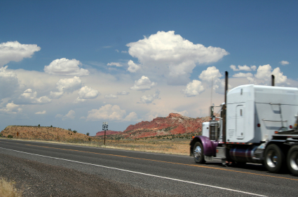
Environmental
Factors Affecting Alertness
Road conditions
Weather
Environmental stress
(heat, noise, vibration)
Vehicle design
Light/dark
Social interaction
Other stimulation
Notes:
Complete Narration: “Environmental factors also affect alertness. These include road conditions, weather, environmental stress (such as heat, noise, and vibration), vehicle design, light and dark, social interaction, and other stimulation. Social interaction (such as conversation) can increase alertness but may also be distracting.”
_______________________
Additional information: Vehicle design factors in driver alertness, performance, and comfort are addressed by the field of ergonomics.

Slide 70
Individual Differences in Fatigue Susceptibility
Topics:
Evidence
Causes
Sleep disorders:
  Obstructive Sleep Apnea
  Insomnia
  Other:
    Narcolepsy
    Restless Leg Syndrome
Are you highly susceptible?
Notes:
Complete Narration: “Another major factor affecting your alertness is your individual susceptibility to fatigue. We’ll talk about the evidence for individual differences in susceptibility and their causes, including sleep disorders. Sleep disorders include Obstructive Sleep Apnea, insomnia, and other conditions such as narcolepsy and restless leg syndrome. Finally, we will ask, “Are you highly susceptible?”

Slide 71
Evidence of Individual Differences
10 Truck Drivers from Safety Study
Notes:
Complete Narration: “First, the evidence. Here we see data for 10 truck drivers from an on-road safety study. The bars show their rate of involvement in driving incidents with high drowsiness. Driver A had a high-drowsiness incident rate of more than 2.5% per hour. Driver B’s rate was about half that, and so on across the ten drivers. On the right side, notice that Drivers G, H, I, and J had no high-drowsiness incidents in the study. These are just ten drivers from a much larger study, but their data illustrates the large individual differences in susceptibility to fatigue. Here, Driver A had almost as many high-drowsiness incidents as the other nine drivers combined.”
___________________
Data from Hickman et al., in press. Also based on Knipling, 2009.

Slide 72
Individual Differences in the
Driver Fatigue & Alertness Study
Notes:
Complete Narration: “A different study, the U.S./Canada Driver Fatigue and Alertness Study, also showed large driver individual differences. The figure shows it in a different way. On the left, we see the drivers, divided into the 14% who had the most drowsy episodes, and the remaining 86%. On the right, we see the observed drowsy periods. The high-risk 14% of the drivers accounted for 54% of all the observed drowsy periods. The remaining 86% accounted for just 46% of the drowsy periods. In other words, more than half of the total risk was from just 14% of the drivers.”
_____________________
Source: Wylie et al., 1996.

Slide 73

What Causes Individual Differences in Fatigue Susceptibility?
Differences in sleep-related behaviors
Differences in health and fitness
Medications
Natural, genetic variations
Sleep disorders; most important: Obstructive Sleep Apnea (OSA)
Notes:
Complete Narration: “What causes individual differences in fatigue susceptibility? First, there are differences in sleep-related behaviors, the good and bad habits we all have. Next are differences in general health and fitness. Many medications have fatigue side effects. There are also natural, genetic variations in our sleep patterns and susceptibility to fatigue. Finally, sleep disorders affect many people. The most important of these is Obstructive Sleep Apnea or OSA.”
___________________
Note: A general reference relating to driver medical qualifications, including OSA, is the FMCSA Medical Examiner Handbook.

Slide 74
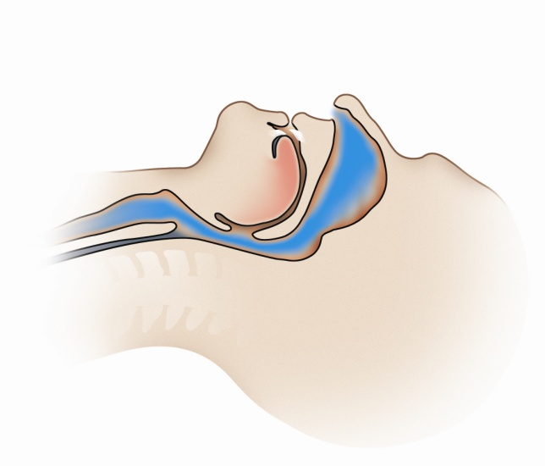
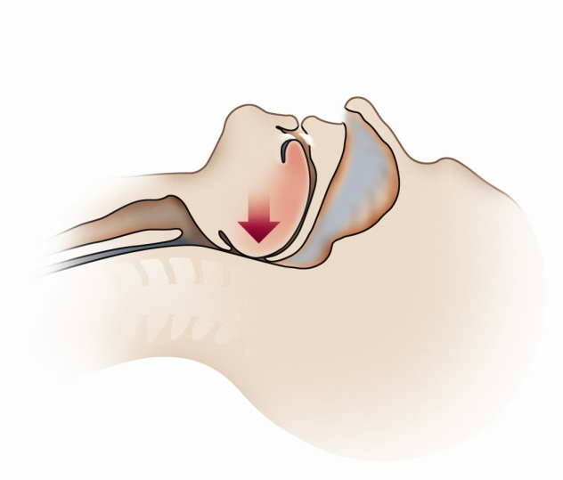
What is Obstructive Sleep Apnea (OSA)?
Apnea = stoppage of breathing lasting 10+ seconds
OSA = breathing stops repeatedly during sleep due to closures of the upper airway
Apnea rate per hour:
  <5 = normal
  >5 = OSA
OSA severity (mild, moderate, severe) based on rate
Some people with severe OSA can have 100 per hour!
© ResMed 2011 Used with Permission
Notes:
Complete Narration: “What is Obstructive Sleep Apnea? An apnea is a stoppage of breathing, despite a person’s efforts to breath, lasting 10 seconds or more. In OSA, breathing stops repeatedly during sleep due to closures of the upper airway. Apnea rates of less than 5 per hour are considered normal, but 5 or more indicates OSA. OSA severity (mild, moderate, or severe) is based on the closure rate, and is determined in a sleep test. Some people with severe OSA can have 100 apneas per hour! Look at the drawings. The first one shows a normal, open airway. The second shows a closed airway, as might occur in OSA.”
_______
Additional instructor note: Modules 7 and 8 contain extensive information on OSA, including video illustrations.

Slide 75

OSA Risk Factors & Warning Signs
Higher risk:
  Obese and overweight individuals
  Male
  40+ years old
  Large neck size (>17” for men, >16” for women)
  Recessed chin, small jaw, or large overbite
  Family history
Physical effects and warning signs:
  Excessive daytime sleepiness and reduced performance
  Snoring
  High blood pressure (hypertension)
  Diabetes
  OSA tends to worsen obesity
Notes:
Complete Narration: “There are a number of distinctive risk factors and warning signs for OSA. Risks are higher for obese and overweight individuals; males; those 40 or older; those with large neck sizes; people with a recessed chin, small jaw, or large overbite; and those with a family history of OSA. Physical effects and warning signs include excessive daytime sleepiness and reduced performance; snoring; high blood pressure; and diabetes. Another effect of OSA is that it worsens obesity. Thus, obesity is both a risk factor for OSA and an effect of it.”
_____________________
Additional information: One study (Xie et al., 2011) found that obese individuals (BMI > 30) had a 29-fold increased OSA risk compared to non-obese individuals. Nonetheless, some people with normal weights can have OSA. OSA risk strongly correlates with obesity and other warning signs, but OSA must be confirmed by a sleep lab study, discussed in subsequent slides.

Slide 76
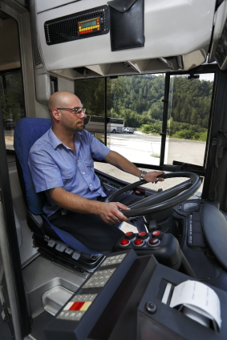
OSA & Driving
Studies of non-CMV drivers suggest 2 to 7-fold crash risk
Can result in medical disqualification (although often undiagnosed and undetected during qualification process)
Estimated 28% of CMV drivers have mild to severe OSA
Notes:
Complete Narration: “OSA is often dangerous for driving, mainly because of drowsiness. Studies of non-CMV drivers with OSA suggest a 2- to 7-fold increased crash risk. OSA can result in medical disqualification for CMV drivers, although it is often undiagnosed and undetected during the qualification process. An estimated 28% of CMV drivers have mild-to-severe OSA.”
________________
Additional information: 2-7 fold crash risk estimate from Sassani et al. (2004). Relative crash risk studies involving CMV drivers have not been definitive and thus are not cited here. The 28% incidence statistic is from Pack et al., 2002.

Slide 77
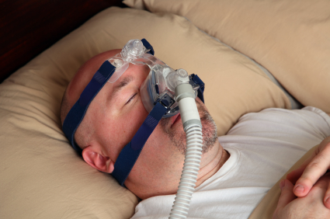
OSA Screening & Treatment
Screening
  Assessment of risk
  Sleep study
Treatments can be very effective if followed; e.g.,
  Continuous Positive Airway Pressure (CPAP) machine
  Weight reduction and behavioral changes
NAFMP Module 8 provides additional driver education
Notes:
Complete Narration: “OSA screening first involves assessment of a person’s risk based on the risk factors described. A person meeting the risk criteria should have a sleep study for a definite diagnosis. Treatments can be very effective if they are followed. One standard treatment is use of a Continuous Positive Airway Pressure (or CPAP) machine during sleep. Another is weight reduction and behavioral changes, including better diet and exercise. Module 8 of this series provides additional driver education on OSA.”
_______
Additional instructor note: Treatments are examples. There are others. CPAP is effective, but only if the treatment is followed faithfully. One night of non-use results in sleepiness the following day. As a discussion topic, you might ask if any students use CPAPs. Do they work? What are the challenges using them. Many people will say that their health and life quality have been greatly improved by CPAP use, even if it is difficult.

Slide 78

Insomnia
Inability to fall or stay asleep
Very common, often related to stress
Usually not a medical condition, though it can be
Irony: Sleeping pills are often used to treat insomnia, yet insomnia can be related to excessive use of sleeping pills
Steps to reduce insomnia:
  Reduce caffeine intake (amount and timing)
  Have a wind-down routine
  Completely darken bedroom
Notes:
Complete Narration: “Another common sleep disorder, Insomnia, is the inability to fall or stay asleep. Insomnia is very common, and often related to daily stress. It is usually not a medical condition, though it can be. One irony of insomnia is that sleeping pills are often used to treat it, but it can be related to excessive use of sleeping pills. You can take steps to prevent insomnia. For starters, reduce your caffeine intake, have a bedtime wind-down routine, and completely darken your bedroom with heavy curtains and no night lights.”
_______
Additional information: The most important question about insomnia is, “What works to reduce it? Sleep-related behaviors such as caffeine use are most important. Individuals with chronic insomnia should see their physicians, however.

Slide 79
Other Sleep Disorders
Restless Leg Syndrome (RLS)
  Afflicts ~5% of adults
  Usually not serious
  Tingling or other leg discomfort causes excessive movement
  Cannot relax to sleep
Narcolepsy
  “Seizure of numbness”
  Fall asleep suddenly
  Lasts a few seconds to 30 minutes
  Extremely dangerous, but rare
Others (e.g., sleepwalking, abnormal circadian rhythms)
Notes:
Complete Narration: “You may have heard of other sleep disorders. Restless Leg Syndrome (or RLS) afflicts about 5% of adults. Usually it is not serious. In RLS, tingling or other leg discomfort causes excessive movement. Sufferers cannot easily relax to sleep. . . . Narcolepsy is a “seizure of numbness.” Narcoleptics fall asleep suddenly, often in the middle of some activity. Their sleep may last from a few seconds to 30 minutes. Narcolepsy is extremely dangerous, but fortunately is rare. There are nearly 80 other sleep disorders (including sleepwalking and abnormal circadian rhythms) but most are rare.”
_______
Additional information: Both Restless Leg Syndrome and Narcolepsy are treatable with drugs. Individuals with Narcolepsy would not likely be commercial drivers. It is a neurologic condition, not a breathing disorder like OSA.

Slide 80

General Symptoms of Sleep Disorders
Different sleep disorders have different symptoms
Excessive daytime sleepiness
Extremes in ability to go to sleep:
  Able to sleep almost immediately, almost anywhere
  Unable to sleep for a long time, even under ideal conditions
Loud, irregular snoring, especially with gasping
Notes:
Complete Narration: ”Different sleep disorders have different symptoms, but here are a few “red flags.” The first is excessive daytime sleepiness. Next are extremes in the ability to go to sleep, such as being able to sleep almost immediately, almost anywhere; or, at the other extreme, being unable to sleep for a long time, even under ideal conditions. Another key symptom is loud, irregular snoring, especially with gasping.”

Slide 81

Are you highly susceptible to fatigue?
Most highly susceptible people don’t know it!
Reasons:
  Self-assessment bias
  Most driving is solitary
  Subjective self-assessments of alertness are poor
  Most sleep disorders are undiagnosed
Solution (be honest with yourself):
  Pay attention to:
    Signs of chronic fatigue
    Objective signs of fatigue while driving
    OSA symptoms and risk factors
  Consider any asleep-at-the-wheel incident to be a red flag!
Notes:
Complete Narration: “Are you highly susceptible to fatigue? Everyone is susceptible, but some are highly susceptible. The problem is, most people who are highly susceptible don’t know it! There are several reasons for this. The first is the self-assessment bias; almost everyone thinks they are good, safe drivers. Most driving is solitary; you can’t directly compare yourself to others. As we learned earlier, subjective self-assessments of alertness are poor. And most sleep disorders are undiagnosed. The solution is to be honest with yourself. Pay attention to signs of chronic fatigue, objective signs of fatigue while driving, and to OSA symptoms and risk factors. Finally, consider any asleep-at-the-wheel incident to be a red flag. If you have had one incident, you are at-risk for another, and the next one could be a lot worse.”
____________
Additional instructor Note: Based on the LTCCS (e.g., Starnes, 2006) and other studies, the fatigue involvement rate in single-vehicle crashes is at least ten times that of multi-vehicle crashes. Any driver involved in a single-vehicle crash should carefully ask himself or herself whether fatigue was a factor.
Optional check on Learning: Q: In this section we listed five causes of individual differences in fatigue susceptibility. Can you remember three of them? A: Differences in sleep-related behaviors, differences in health and fitness, medication use, natural genetic variations, and sleep disorders.”

Slide 82
Lesson 2 Quiz
Which is true of Rapid Eye Movement (REM) sleep?
  Takes up the majority of sleep time
  Includes four repeating stages ranging from light to deep sleep
  The brain is active
  Frequent “tossing and turning”
Notes:
Answer: C. The others describe “regular” or non-REM sleep.

Slide 83
Lesson 2 Quiz
Joe needs about 7 hours of sleep each day but for several nights gets only 6. We would say that Joe has:
  A disrupted circadian rhythm
  A sleep debt
  A sleep disorder
  Sleep inertia
Notes:
Answer: B. Sleep deprivation, even by one hour a day, results in a sleep debt.

Slide 84
Lesson 2 Quiz
Which statement is true about circadian rhythms?
  Controlled by the brain
  Can completely shift in a day or two
  Not affected by dark and light
  “Night owls” actually perform better during the overnight hours than during the daytime.
Notes:
Answer: A.

Slide 85
Lesson 2 Quiz
Which of the following is most associated with decreased oxygen to the brain?
  Obstructive Sleep Apnea (OSA)
  Insomnia
  Narcolepsy
  Restless Leg Syndrome
Notes:
Answer: A. OSA affects breathing and thus oxygen to the brain. The others ordinarily do not.

Slide 86
Lesson 2 Quiz
Which is NOT a risk factor or warning sign for Obstructive Sleep Apnea (OSA)?
  Being a male over 40 years old
  Obesity
  Loud snoring
  Having a small neck size
Notes:
Answer: D. A large neck size is a risk factor.

Slide 87
Lesson 3: Health, Wellness,
Drugs, & Medications
Notes:
Complete Narration: “Driver Education Lesson 3 addresses Health, Wellness, Drugs, and Medications.”

Slide 88
Health & Wellness
Topics:
Importance
Personal keys to wellness
Diet and nutrition
Exercise
Weight
Smoking
Stress
Personal relationships
Steps in behavior change
Notes:
Complete Narration: “The topic of Health and Wellness encompasses its importance, personal keys to wellness, diet and nutrition, exercise, weight, smoking, stress, personal relationships, and steps in behavior change.”
_______
Additional instructor note:
Learning objectives for this section include:
(K) Recognize personal benefits of health and wellness
(K, A) Recognize and value five personal keys to wellness
(K) Recognize the approximate incidence of major health threats (e.g., being overweight, smoking) among CMV drivers.
(K) Recognize societal and individual effects of poor health behaviors (e.g., poor diet, lack of exercise, being overweight, smoking, stress, poor personal relationships).
(K) Recognize behaviors supportive of wellness; i.e., good diet, physical activity, normal weight, not smoking, stress management, positive relationships.
(K) Recognize five steps to behavior change.
(S) Apply knowledge of health and wellness to personal self-management.
(A) Value wellness and wellness-enabling behaviors.

Slide 89

Health & Wellness:
What’s in it for you?
How you look and feel
Alertness and performance while driving
Longevity on the job
Increased life expectancy
Some unhealthful behaviors are about twice as common among commercial drivers as in general population
Notes:
Complete Narration: “Health and wellness – what’s in it for you? A lot! Your health affects how you look and feel, your alertness and performance while driving, your longevity on the job, and your life expectancy. One study found some unhealthful behaviors and other indicators to be about twice as common among CMV drivers as in the general population. This included behaviors like smoking and behavior-related medical conditions like high blood pressure.”
_______
Additional information:
Study cited: Roberts and York (2000), study sponsored by the U.S. DOT and performed by the National Private Truck Council (NPTC). Examples of percentages cited in report:
Smoking: ~50% of truck drivers versus ~25% of general population.
Overweight: >70% of truck drivers versus ~32% of general population [in 1994; greater today]
High blood pressure: ~44% of truck drivers versus ~26% of general population.
Preliminary data from a 2011 National Institute of Occupational Safety & Health (NIOSH) survey:
Smoking: 46% of truck drivers versus 21% of the U.S. population
Obese: 65% vs. 34%
“Fair” or “poor” health (self-reported): 18% vs. 10%.
Diabetes: 14% vs. 8%.

Slide 90
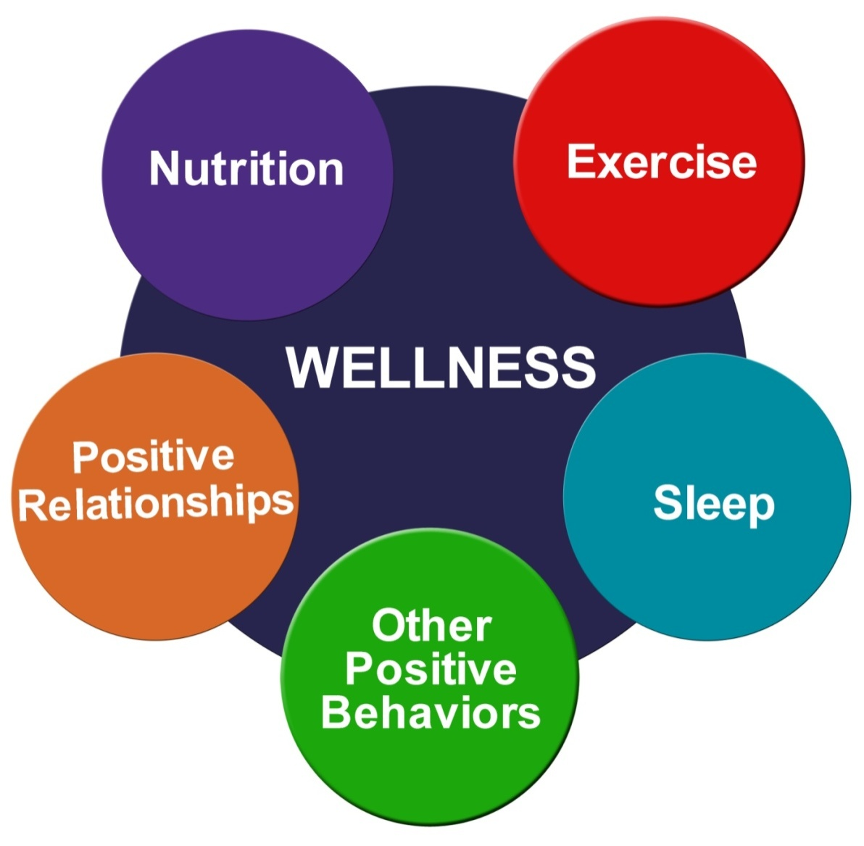
Personal Keys to Wellness
Notes:
Complete Narration: “There are at least five keys to wellness. Start with a nutritious diet. Other keys include exercise, sleep, other positive behaviors (like not smoking), and positive relationships. Changing your behavior in these five areas will bring personal wellness, better performance, and more happiness to your life.”

Slide 91


Diet & Nutrition (1 of 2)
Too much food, fat, salt
CMV drivers’ favorite foods: steak & burgers
Leading causes of death related to what people eat
Many fried and processed foods are not healthful
Good foods: grains, fruits, vegetables, low-fat milk products, lean meats, fish, nuts
Notes:
Complete Narration: “Let’s start with diet and nutrition. People today eat too much food, too much fat, and too much salt. One survey of CMV drivers found their favorite foods to be steak and burgers! Most of the leading causes of death are related to what people eat. Many fried and processed foods are not healthful. Good foods include grains, fruits, vegetables, low-fat milk products, lean meats, fish, and nuts.”
_______
Survey cited: Holmes et al. (1996), in Krueger et al., (2007)

Slide 92

Diet & Nutrition (2 of 2)
Simple Behavioral Goals:
Strive for Five: 5 servings of fruits or vegetables daily
Replace bad fats (e.g., chips) with good fats (e.g., nuts)
Replace bad carbs (e.g., sweets, potatoes) with good carbs (e.g., whole grains)
Replace sweet drinks with water
Notes:
Complete Narration. “Set some simple behavioral goals for your diet. First, Strive for Five. That’s 5 servings of fruits or vegetables daily. Replace bad fats (such as chips) with good fats (such as nuts). Replace bad carbs (for example, sweets and potatoes) with good carbs (such as whole grains). Also, replace sweet drinks with plain ole water.”

Slide 93

Exercise (1 of 2)
Recommendation:
  2.5 hours per week aerobic exercise (e.g., fast walking)
  + Muscle-strengthening workouts twice a week (e.g., weightlifting, pushups).
Benefits:
  Improves digestion
  Reduces weight
  Raises energy level, mood, self-esteem
  Reduces stress
  Improves sleep (if 3+ hours before sleep)
  Reduces disease risks
Notes:
Complete Narration: “Next to diet, exercise is probably the most important wellness behavior. Health experts recommend 2.5 hours per week of aerobic exercise like walking, plus muscle-strengthening workouts twice a week. Exercise has many benefits. It improves digestion; reduces weight; raises energy level, mood, and self-esteem; reduces stress; and improves sleep (as long as you exercise 3 or more hours before bedtime). Exercise also reduces disease risks. This includes diabetes, heart disease, osteoporosis, arthritis, and even some cancers.”
_______
Exercise recommendations from the Centers for Disease Control and Prevention.

Slide 94


Exercise (2 of 2)
Strategies:
10-minute walks twice or more per day
Work out more vigorously on weekends
Take exercise equipment with you on trips
Keep a record of your exercise
Set daily and weekly goals
Find out what you like and do it!
Notes:
Complete Narration: “Here are some strategies for getting more exercise. Take 10-minute walks twice or more per day. Work out more vigorously on weekends. Take exercise equipment (such as a jumping rope, bicycle, or barbells) with you on trips. Keep a record of your exercise; maybe just mark it on your calendar. Set daily and weekly goals. Most importantly, find out what you like and do it!”
_______
Additional information: Walking around a tractor-semitrailer 50 times = 2 miles!

Slide 95
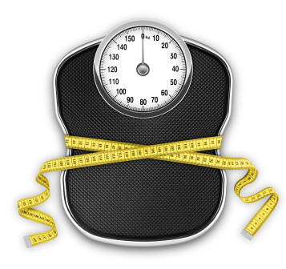
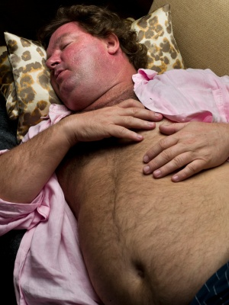
Weight
  CMV drivers:
    ~50% are obese
    Another ~25% are overweight
Body-Mass Index (BMI)
  Weight/Height² × 703
  Scale:
    <25 = normal
    25-30 = overweight
    >30 = obese
Being overweight/obese increases risks of heart disease, high blood pressure, Diabetes, OSA, other injuries, and some cancers
Strategies: diet and exercise
Notes:
Complete Narration: “If you don’t exercise and eat a healthy diet, you are probably overweight. About half of CMV drivers are obese and another 25% are overweight. Body-Mass Index, or BMI, is a measure of how fat or thin you are. Take your weight in pounds, divide it by your height in inches squared, and multiply that by 703. A BMI of less than 25 is normal. 25 to 30 means you are overweight. A BMI above 30 means you are obese. Being overweight or obese increases your risks of heart disease, high blood pressure, diabetes, OSA, asleep-at-the-wheel and medical-related crashes, other injuries, and even some cancers. There are just two strategies for losing weight: diet and exercise.”
_______
Weight studies: Korelitz et al. (1993), Hickman et al. (in press).
Additional information: Preliminary data from a 2011 National Institute of Occupational Safety & Health (NIOSH) survey shows even higher percentages for CMV driver overweight and obesity: 89% overweight vs. 68% of U.S. adults; 65% obese vs. 34% of U.S. adults.
Determining BMI in the metric system is much easier; simply take your weight in kilograms and divide it by your height in meters, squared.
Obese drivers are less likely to wear safety belts, perhaps because belts are uncomfortable for them. This puts them at even greater risk. Source: Wiegand et al., 2008.

Slide 96
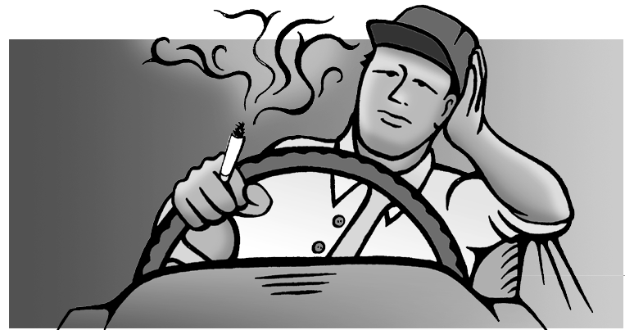
Smoking & Other Tobacco Use
Leading preventable cause of disease, death, and disability
~20% of Americans smoke, but nearly half of CMV drivers do
Causes lung cancer, COPD and other lung diseases, heart disease, and many other medical conditions
>$1,000 per year in medical costs for each smoker
Reduces oxygen flow to the brain; worsens OSA
Strategy: QUIT!!!
  See your doctor
  Call 1-800-QUIT-NOW
  Click www.smokefree.gov or
  Click www.hc-sc.gc.ca
Notes:
Complete Narration: “Smoking, along with other tobacco use, is the leading preventable cause of disease, death, and disability. About 20% of Americans smoke, but nearly half of CMV drivers do. Smoking causes lung cancer, COPD and other lung diseases, heart disease, and many other medical conditions. Smoking also costs each smoker more than $1,000 per year in medical costs, on average. Smoking reduces oxygen flow to the brain, and it worsens OSA. To quit smoking, see your doctor for medical advice and assistance. You can also call 1-800-QUIT-NOW or visit www.smokefree.gov or www.hc-sc.gc.ca for the quitline in your Province.”
_______
Additional information: Preliminary data from a 2011 National Institute of Occupational Safety & Health (NIOSH) survey: 46% of surveyed CMV drivers smoked, versus 21% of U.S. adults. In a survey of nearly 3,000 truck drivers, Korelitz et al. (1993) found that 54% smoked, compared to 28% of all U.S. males and 25% of females at the time. Medical cost data from American Lung Association.
COPD = Chronic Obstructive Pulmonary [lung] Disease

Slide 97

Stress (1 of 2)
Symptoms:
Headaches
Sleep disturbances
Difficulty concentrating
Short temper
Upset stomach
Job dissatisfaction
Low morale
Notes:
Complete Narration: “Commercial driving can be stressful! The job involves long hours, fighting traffic, schedule pressure, and isolation from family and friends. One study found CMV driver stress to be higher than 90% that of the population. Stress symptoms include headaches, sleep disturbances, difficulty concentrating, short temper, upset stomach, job dissatisfaction, and low morale.”
_______
Study cited in narration: Orris et al, 1997.

Slide 98

Stress (2 of 2)
Strategies:
Positive outlook and behaviors
Balance between work and personal life
Pursue personal interests
Support network
Try to improve job environment
Get serious about relaxing!
  Relaxation breathing
  Short walks
  Meditation
  Reading
  Find method that works best for you
Notes:
Complete Narration: “There are effective strategies to deal with stress. Embrace a positive outlook and positive behaviors relating to sleep, diet, and exercise. Relax a bit. Strike a balance between work and your personal life. Pursue personal interests; for example, take a book you like to read with you on trips. Find and sustain a support network of family, friends, and co-workers. Look for ways to improve your job environment in constructive ways. For example, choose to stop at travel plazas where you have gotten good rest and nutritious meals. Finally, get serious about relaxing! Learn about relaxation breathing and give it a try. Take short walks, meditate, read -- experiment until you find a method that works best for you.”

Slide 99


Personal Relationships:
Family & Friends
Driver survey: Lack of family time was the biggest single health and wellness concern
Driver personal and family problems sometimes lead to unsafe driving and accidents
Strategies:
  Keep in touch, communicate
  Value and foster each relationship
  Do fun things together
  Be positive
  Show support
Notes:
Complete Narration: “Wellness includes positive personal relationships with family and friends. One CMV driver survey found that lack of family time was the biggest single health and wellness concern. Therefore, make the most of the time you have together! Other personal relationships are important, too. This includes extended family, neighbors, co-workers, and customers. On the negative side, driver personal and family problems sometimes lead to unsafe driving and to accidents. To sustain positive relationships, keep in touch and communicate with family and friends. Value and foster each relationship. Do fun things together like going for a family outing. Be positive, and show support for each other.”
_______
Additional information. Survey: Roberts & York, 2000. Top ten driver health concerns based on survey of 448 CMV drivers (in order): lack of family time, lack of exercise, weight, fatigue, poor diet, stress, lack of sleep, heart disease, cancer, high blood pressure. Of course, survey responses are subjective.

Slide 100
Steps to Behavior
Change
Health, Wellness, Alertness, Performance
Sustaining action
Aware, thinking
of change
Unaware
of
problem
Taking action
Planning
to change
Notes:
Complete Narration: “Behavior change is not easy. Usually, you have to take it one step at a time. Research has suggested that there are five steps along the way toward better behavioral health. At first, a person is unaware of their problem (or perhaps just unwilling to think about it!). So they have to become aware of the problem and start thinking about changing. Thinking becomes planning, and next becomes action. Just taking action is not enough since it is always easy to slip back. The final step is sustaining action and enjoying the benefits. Benefits include health, wellness, alertness, and better performance. Take a moment to think about your own health behaviors, and what steps you are on.”
_______
Additional instructor note: Module 5 contains much more detail on the five steps to behavior change. You may want to discuss some of those details in class.
Optional check on learning: Q: Earlier, we talked two different kinds of exercise you should engage in. What were they?
A: Aerobic and muscle-strengthening. Note: A weekly goal for aerobic exercise is 2.5 hours.

Slide 101
Drugs & Medications
Topics:
Caffeine
Other stimulants
Sleep aids: supplements and herbal teas
Sleeping pills
Side effects of other medications
Alcohol
Notes:
Complete Narration: “Many different drugs and medications affect alertness and sleep. This includes caffeine, other stimulants, supplements and herbal teas used as sleep aids, sleeping pills, side effects of other medications, and alcohol.”
_______
Additional instructor note:
Learning objectives for this section include:
(K) Recognize effects of caffeine
Negative effects on sleep
Correct use of caffeine to support alertness.
(K) Recognize negative effects of stimulants (e.g., Dexedrine)
(K) Recognize main categories of sleeping pills (hypnotics)
(K) Recognize supplements and herbal teas used as sleep aids.
(K) Recognize correct use of sleeping pills.
(K) Recognize negative effects of alcohol on sleep.
(A) Value moderation in use of alcohol, sleep aids, and caffeine.
Additional information: Krueger et al. (2011) is a good, general source of information of the effects of drugs and medications on CMV driver health and performance.

Slide 102
Caffeine
The most widely used stimulant
In coffee, tea, most sodas, energy drinks, some medications
Generally safe and healthy if used in moderation
Improves alertness and performance
Effects and tolerance vary widely
Effective fatigue countermeasure, but not a substitute for sleep
Notes:
Complete Narration: “Caffeine is the most widely used stimulant. Caffeine is found in coffee, tea, most sodas, energy drinks, and some medications. It is generally safe and healthy if used in moderation. Caffeine does improve alertness and performance, though its effects, and individual tolerance for it, vary widely. Caffeine is an effective fatigue countermeasure, but is not a substitute for sleep.”
_______
For additional information on the behavioral effects of caffeine and other drugs, see Krueger et al. (2011).

Slide 103

Using Caffeine
Alerting effects:
  Begin in ~20 minutes
  Peak in 60-90 minutes
  Can last for hours
Caffeine content in coffee varies widely
Tea and most cola drinks have about ½ the caffeine of coffee
Large individual differences in the time required to metabolize caffeine
Drink in small sips to “nurse” the cup over a longer period
Notes:
Complete Narration: “To use caffeine effectively, there are a few things you should know. Caffeine’s alerting effects begin about 20 minutes after ingestion, and peak in 60 to 90 minutes. Its effects can last for hours, however. Caffeine content in coffee varies widely; it can range from 75 to 250 milligrams per 8-oz cup. Tea and most cola drinks have about one-half the caffeine of coffee. There are large individual differences in the time required to metabolize caffeine. For best alerting effects, try drinking coffee in small sips to “nurse” the cup over a longer period. This extends the alertness boost. And don’t forget other drinks like water and fruit juice. They don’t have caffeine but they are healthy and help keep you alert by reducing dehydration.”
_______
Principal source: Krueger et al. (2011).

Slide 104

Caffeine & Sleep
Like any stimulant, caffeine makes sleep more difficult
Generally, avoid caffeine within 6-8 hours of main sleep period
Effects vary - some people are even more sensitive
If you have trouble going to sleep:
  Reduce caffeine intake
  Increase time between last dose & bedtime
Notes:
Complete Narration: “Like any stimulant, caffeine makes sleep more difficult. Avoid caffeine within 6 to 8 hours of your main sleep period, and 3 to 4 hours before taking a nap. Effects vary widely, and some people are even more sensitive. If you have trouble going to sleep, reduce your caffeine intake, and increase the time between your last dose and bedtime.”
_______
Principal source: Krueger et al. (2011).
Additional information: Some studies have suggested that it is possible to drink coffee immediately before a nap. It takes about 20-30 minutes for the caffeine to become effective, so one can nap during that short period. Drivers may want to experiment with this approach.

Slide 105

Two Harmful Stimulants
Amphetamines are illegal or available only with a prescription. Too strong for general use
  Increase activity level but do not improve performance reliably
  Increase heart rate and metabolism, sometimes dangerously
  Often you “crash” several hours after use
Nicotine does not improve alertness or performance. Smoking reduces oxygen flow to the brain
Notes:
Complete Narration: “Other stimulants should be avoided unless they have been prescribed by a doctor. Amphetamines, for example, are illegal or available only with a prescription. They are too strong for general use. They increase activity level, but do not improve performance reliably. Amphetamines increase heart rate and metabolism, sometimes dangerously. Often you “crash” several hours after their use, feeling extreme fatigue and depression, but unable to sleep. The nicotine in cigarettes is not an effective stimulant; it does not improve alertness or performance. In addition, smoking reduces oxygen flow to the brain.”
_______
Additional comment: Use of illegal drugs like amphetamine is low among CMV drivers, in part due to drug testing. Smoking rates are very high, however, as discussed earlier.

Slide 106

Sleep Aids: Supplements
& Herbal Teas
Melatonin
  Natural hormone secreted every evening and related to sleep
  Small doses can facilitate nightly sleep
  Tablets tend to have much higher doses than needed
  No serious side effects known but has not been thoroughly tested
Valerian root
  Contains mixture of chemicals
  Sleep benefits reported
Supplements are not tested or regulated by the government
Notes:
Complete Narration: “Some supplements and herbal teas are used as sleep aids. Melatonin is a natural hormone secreted in your body every evening, and is related to sleep. Small doses of melatonin can facilitate nightly sleep. The tablets sold in drug stores tend to have much higher doses than are needed, however. No serious side effects of melatonin use are known, but it has not been thoroughly tested. Valerian root is an herbal tea containing a mixture of chemicals. Sleep benefits from its use have been reported. Unlike drugs, supplements are not tested or regulated by the government. Therefore, their effectiveness and safety may be uncertain.”
_______
Source: Krueger et al. (2011).
Additional information: Ramelteon (also called Rozerem) is a prescription drug which replicates the action of melatonin. Some studies suggest that it is safer for long-term use than hypnotic sleeping pills. Various other supplements and herbal teas (e.g. Chamomile, Kava Kava, Passion Flower). Benefits and safety not documented.

Slide 107

Sleeping Pills (1 of 2)
Hypnotics = drugs used to induce sleep
Some also used to treat anxiety and stress disorders
General categories:
  Non-prescription Over-The-Counter (OTC); e.g., Tylenol PM, Benadryl
  Prescription:
    Benzodiazepines (e.g., Halcion, Restoril)
    Nonbenzodiazepines (e.g., Ambien, Sonota, Lunesta)
Notes:
Complete Narration: “Sleeping pills are technically known as hypnotics, drugs used to induce sleep. Some are also used to treat anxiety and stress disorders. There are two general categories. First there are non-prescription, Over-The-Counter drugs like Tylenol PM and Benadryl. Two types of prescription hypnotics include Benzodiazepines (such as Halcion and Restoril), and the newer nonbenzodiazepine sleeping medications like Ambien, Sonota, and Lunesta.”
_______
Additional information: A new prescription nonbenzodiazepine sleeping pill called Intermezzo is designed for those who wake up in the middle of the night and cannot get back to sleep. Its effects last about 4 hours. The same cautions about other sleeping medications apply.

Slide 108
Sleeping Pills (2 of 2)
Cautions:
  No sleeping pill provides 100% natural sleep
  Most have side effects
  Most are habit-forming
  Some cause withdrawal symptoms
  Must allow full time for drug to leave your body before driving
Notes:
Complete Narration: “Sleeping pills can be effective and safe, but there are some important cautions. First, no sleeping pill provides 100% natural sleep. Most have side effects. Most are habit-forming , and some cause withdrawal symptoms. Finally, for safe use you must allow the full time for the drug to leave your body before driving. If a drug works for 8 hours, don’t try to drive before that time.”
_______
Additional information: Recent research has suggested that use of sleeping pills can reduce overall longevity. Drivers should consider checking with their doctors and making efforts to reduce or stop sleeping pill use.

Slide 109

Other Medications Have
Fatigue Side Effects
Common side effects:
  Drowsiness
  Other fatigue
  Insomnia
Accordingly, many prescriptions specify when the drug should be taken (e.g., at bedtime)
Follow dosage instructions carefully
Safety regulations restrict driver on-road use of medications with stated fatigue side effects
Notes:
Complete Narration: “Finally, other medications you may take may have fatigue side effects. Common medication side effects include drowsiness, other fatigue, or insomnia. Accordingly, many prescriptions specify when the drug should be taken, such as at bedtime. Follow dosage instructions carefully. Discuss side effects with your prescribing physician, and make sure that he or she understands the importance of alertness to your work and personal safety. Also, remember that safety regulations restrict driver on-road use of medications with stated fatigue side effects.”
_______
Additional information: Fortunately, medication use per se is not known to be a major direct cause of crashes; but it can contribute to them. For example, most Benzodiazepines cause drowsiness, especially if combined with alcohol.

Slide 110

Alcohol: Not a Sleep Medication
Not permitted in CMVs
Some drivers may use alcohol as a sleep aid at home.
Alcohol may make you sleepy, but it actually disrupts sleep:
  Disrupts REM (dream) sleep
  Causes “rebound” awakening after a few hours
Disruptive effects increase with age
Performance impairment effects greater when you are also sleepy
Alcohol makes OSA worse
Notes:
Complete Narration: “Alcohol is not permitted in U.S. or Canadian CMVs. However, some drivers may use alcohol as a sleep aid when they are at home. Alcohol may make you sleepy, but it actually disrupts sleep. It disrupts REM sleep and dreaming. And it causes “rebound” awakening after a few hours, when alcohol oxidizes in the blood. Maybe you have had the experience of drinking in the evening and later awakening 3 or 4 hours after going to sleep. The disruptive effects of alcohol on sleep increase with age, and performance impairment effects are greater when you are also sleepy. Finally, alcohol makes OSA worse. Your throat tissue becomes more relaxed and thus closes more easily.
_______
Additional information: Alcohol use by CMV drivers is rare as a primary cause of crashes.
Review question on drugs and medications: Q: The peak effects of caffeine occur about how long after drinking a cup of coffee? A: 60 to 90 minutes.”

Slide 111
Lesson 3 Quiz
One survey of CMV drivers found which foods to be their favorites?
  Fruits and vegetables
  Grains and nuts
  Lean meats and fish
  Steaks and burgers
Notes:
Answer: D. And D is the least healthful of these foods.

Slide 112
Lesson 3 Quiz
At least 75% of CMV drivers exhibit which unhealthful condition or behavior?
  Fatigue from excessive exercise
  Being overweight or obese
  Smoking
  Poor personal and family relationships
Notes:
Answer: B. At least 50% are obese and another 25% are overweight.

Slide 113
Lesson 3 Quiz
Which statement is true about caffeine?
  Increases feeling of alertness but not actual performance
  Effective as a substitute for sleep
  Effects vary widely in different people
  Fully metabolized within 1-2 hours of ingestion
Notes:
Answer: C.

Slide 114
Lesson 3 Quiz
Which may make you sleepy but actually disrupts sleep and often wakes you up later?
  Caffeine
  Nicotine
  Alcohol
  Melatonin
Notes:
Answer: C.

Slide 115
Lesson 3 Quiz
Which is a natural hormone that is secreted by your body every evening?
  Caffeine
  Melatonin
  Amphetamine
  Nicotine
Notes:
Answer: B.

Slide 116
Lesson 4: Alertness & CMV Driving
Notes:
Complete Narration: “Lesson 4 is Alertness and CMV Driving. Topics include Improving Sleep and Alertness, Scheduling and Hours-of-Service, and Team Driving.”

Slide 117
Improving Sleep & Alertness
Topics:
Fatigue management challenges faced by CMV drivers
General strategies
At-home practices
On-road practices:
  General
  Night driving
  Dealing with shift and time zone changes
Notes:
Complete Narration: “You can apply your knowledge of sleep principles to improve your sleep and alertness. This section covers fatigue management challenges faced by CMV drivers, general strategies for improving sleep and alertness, at-home practices, and on-road practices. The latter includes general tips, tips for night driving, and dealing with shift and time changes.”
________
Additional instructor note:
Learning objectives for this section include:
(K) Recognize the various fatigue management challenges faced by CMV drivers
(K) Recognize positive strategies and practices (general, at-home, on-road).
(K) Recognize specific in-vehicle behaviors which do or do not promote alertness.
(K) Recognize fatigue-related concerns about night driving and shift changes.
(S) Apply fatigue management knowledge to successful night driving and/or shift changes.
(A) Value safety belt use (in part because of its importance in road departure crashes).

Slide 118

Driver Fatigue Management Challenges (1 of 2)
Often a tight schedule for getting main sleep
Extended work hours
(+ commuting for many)
Changing work schedules
Work/sleep periods conflict with circadian rhythms
Limited time for naps and other rest
Notes:
Complete Narration: “CMV drivers may face multiple fatigue management challenges. These may include a tight schedule for getting one’s main sleep, extended work hours (plus commuting time for many drivers), changing work schedules, work and sleep periods which may conflict with circadian rhythms, and limited time for naps and other rest on the road.”

Slide 119

Driver Fatigue Management Challenges (2 of 2)
Unfamiliar or uncomfortable sleep locations
Disruptions of sleep
Limited opportunities for exercise
Difficulty in finding healthy foods on the road
Environmental stressors (e.g., noise, heat, cold, lack of ventilation)
Notes:
Complete Narration: “Additional fatigue management challenges faced by many drivers include unfamiliar or uncomfortable sleep locations, disruptions of sleep, limited opportunities for exercise, difficulty in finding healthy foods on the road, and environmental stressors like noise, heat, cold, and lack of ventilation. It’s tough to meet all these challenges.”
________
Additional instructor note: A follow-up question might focus on effective solutions to the biggest challenges.

Slide 120

General Strategies to Meet
These Challenges
SLEEP!!!
  Main sleep
  Naps
Maintain a healthful lifestyle
Try to keep a regular schedule
Go with your circadian rhythm – don’t fight it
Wind down before sleep
  Less physical activity
  Lower lights
Be smart about caffeine use
Notes:
Complete Narration: “Fortunately, there are some helpful strategies and practices. First and foremost, sleep! Get plenty of “anchor” sleep in your main sleep period, and take naps. Maintain a healthful lifestyle, including diet, exercise, positive behaviors, and positive relationships. To the extent possible, try to keep a regular schedule. Go with your circadian rhythm – don’t fight it. Wind down before sleep; reduce physical activity and lower the lights. And be smart about caffeine use – learn what’s right for you and don’t exceed that.”

Slide 121

At-Home Strategies
Get the best sleep possible before starting a trip or work week
Communicate your sleep needs and get your family’s support
Bedroom should be:
  Completely dark
  Cool
  Quiet
Pre-sleep routine
Be active but don’t exhaust yourself. Take time to relax
Notes:
Complete Narration: “Sleep hygiene starts at home. Get the best sleep possible before starting a trip or work week. Any extra sleep you get at home will, to some extent, help you all week. Communicate your sleep needs and get your family’s support. Your bedroom should be completely dark, cool, and quiet. Develop a pre-sleep routine. Be active at home but don’t exhaust yourself. Take time to relax.”

Slide 122

On-the-Road Strategies
Try to get as much sleep on the road as you get at home
Rest breaks with naps very beneficial
Also beneficial:
  Rest breaks without naps
  Moving your body
  Conversation if it is not distracting
Stimulation alone has little effect
Exercise
Avoid heavy meals
Wear your safety belt!
Notes:
Complete Narration: “When you’re on the road, try to get as much sleep each night as you get at home. Don’t even start to get sleep-deprived! Rest breaks with naps are very beneficial. Also beneficial, though less so, are rest breaks without naps, moving your body (such as setting the cruise control so you can move your feet), and conversation, if it is not distracting. Some people find listening to talk radio or sports broadcasts to be helpful. Stimulation alone, such as loud music, has little effect. You should exercise, but not strenuously near bedtime. Avoid heavy meals, especially at lunchtime. Instead of a big meal, eat light, healthy snacks. Finally, wear your safety belt! Fatigue-related crashes are often road departures and rollovers. These are crashes where safety belt use is most critical for survival.”
________
Additional information on safety belt use: Many fatigue-related crashes are rollovers because CMVs leave the road and roll down embankments. Among major crash types, rollovers generally cause the most severe injuries for CMV drivers. Safety belts have their greatest benefits in CMV rollover crashes. Thus the importance of safety belt use! Source: Knipling, 2009.

Slide 123


Night Driving
Advantage of night driving: less traffic!
Disadvantages:
  Fatigue, related to circadian rhythms
  More drunk/reckless motorists
  Poor visibility
Use light and dark to “fool” your body:
  Bright lights simulate daybreak
  Dark simulates night and bedtime
Use caffeine, but carefully
Consider taking sleeper berth period/nap in pre-dawn hours
Get more recovery sleep on weekends
Not for everybody!
Notes:
Complete Narration: “Night driving is especially challenging for fatigue management. Night driving has one big safety advantage: less traffic! Disadvantages include increased fatigue (related mostly to circadian rhythms), more drunk and reckless motorists on the road, and poor visibility. Because it is naturally difficult to stay awake overnight and to sleep during the day, you should use light and dark to “fool” your body. Bright lights simulate daybreak and help to wake you up. Dark simulates night and bedtime. Use caffeine, but carefully. If you drink too much, it will disrupt your sleep. Consider taking a sleeper berth period or other nap in pre-dawn hours when fatigue risk is greatest. If you work nights, you will want and need more recovery sleep on weekends. Night driving is not for everybody! Some people never adjust to night driving and shouldn’t keep trying.”
________
Additional information: Opinions differ about the overall safety of night driving versus day driving. In regard to fatigue, however, there is no question that risk is greater during the overnight hours. In regard to the use of light to simulate daybreak, one should realize that the beneficial effects are not sufficient to overcome significant sleep loss. Bright lights help to keep you awake, but you cannot completely fool your body. Darkness, however, is almost always beneficial for improved sleep. Daytime sleepers should ensure that their sleeping quarters are completely dark.

Slide 124

Dealing with Shift &
Time Zone Changes
Be aware of your “body clock”
Short trips/shift changes: stick with your regular sleep schedule
Longer changes:
  “Pre-adjust” before change
  Shift your pre-bed, “evening” routine
  Use light and dark to help you adjust
  To stay awake, be physically active and interact with others
Getting more sleep generally makes changes easier
Notes:
Complete Narration: “As a CMV driver, you have likely worked different shifts and driven across several time zones. To deal with these changes, be aware of your “body clock.” For short trips and shift changes, stick with your regular sleep schedule. For longer changes, there are several strategies you can try. When possible, “pre-adjust” your sleep schedule before the change. This might include shifting your pre-bed, “evening” routine. Use light and dark to help you adjust. Bright lights will help you stay awake while darkness will help you sleep. In addition, to stay awake, be physically active and, when possible, interact with others. Finally, remember that getting more sleep generally makes shift and time changes easier.”
________
Optional check on learning: Q: Describe a good pre-sleep routine.
A: Wind down, relax, and perhaps lower the lights.

Slide 125
Scheduling & Hours-of-Service
Topics:
Principles of sound scheduling
Schedule regularity; forward vs. backward rotations
Current HOS rules and their scientific rationales
Factors affecting your alertness and performance
Driver obligations
Notes:
Complete Narration: “As a CMV driver, you must schedule your work and manage your fatigue within the framework of Hours-of-Service rules. This section covers scheduling and Hours-of-Service. This includes principles of sound scheduling, schedule regularity (including forward and backward schedule rotations), current HOS rules and their scientific rationales, a review of all the factors affecting your alertness and performance, and a review of your compliance and safety obligations as a driver.”
_______
Additional instructor note:
Learning objectives for this section include:
(K) Recognize principles of sound scheduling; e.g., schedule regularity.
(K) Distinguish forward rotation from backward rotation, and relation to fatigue management.
(K) Identify key HOS rules and their relation to sleep hygiene.
(K) Recognize good and bad fatigue management work schedules (e.g., irregular, backward rotating).
(K) Recognize major advantages and limitations of HOS rules.
(K) Recognize factors affecting driver alertness [including HOS compliance].
(A) Accept two driver obligations: HOS compliance and self-management “beyond compliance.”
Additional information: This instruction does not cover the details of HOS rules and students are not tested on their knowledge of specific rules (e.g., 10-hour rule, 14-hour rule, etc.). Instructors should avoid getting into detailed discussions about specific HOS rules; instead, focus on fatigue management principles.

Slide 126
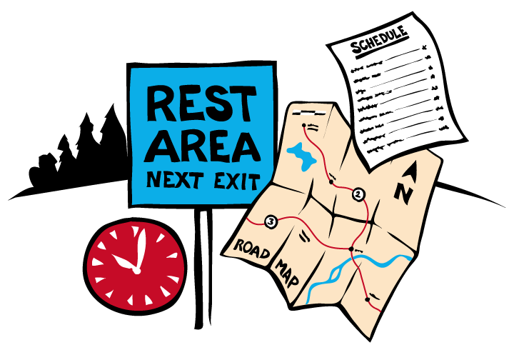
Basic Sleep-Rest
Scheduling Practices
Regular schedule best
Strive for 7-8 hours sleep
Allow for commuting time
Allow for rest breaks and naps during work periods
Total time awake 16-17 hours per day or less
Work and rest cycle consistent with circadian rhythms when possible
Notes:
Complete Narration: “Here are some basic sleep-rest scheduling practices you should follow. A regular schedule is best. Strive for 7 to 8 hours of daily sleep. Allow for commuting time in your personal scheduling. During commuting time, you may be legally off-duty but your body and brain are “on-duty.” Allow for rest breaks and, better yet, naps during your work periods. Your total time awake each day should be 16 or 17 hours, or less. Finally, your work and rest cycle should be consistent with circadian rhythms when possible.”

Slide 127
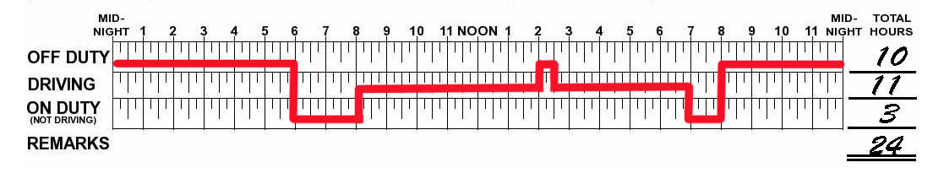
Schedule Regularity
Stable, regular schedules best!
Schedule rotations: gradual better than abrupt
Schedule rotations: forward better than backward
Day 1
Day 2
Day 3
Notes:
Complete Narration: “To the extent possible, strive for schedule regularity. Stable, regular schedules are best for your performance, sleep hygiene, digestion, heart health, and overall wellness. If you have to rotate your schedule, small, gradual changes are better than abrupt ones. Further, forward rotations are better than backward rotations. In the logs shown, a truck driver is working the full maximum U.S. daily limits, but it is a regular schedule providing 10 hours off each night.”

Slide 128
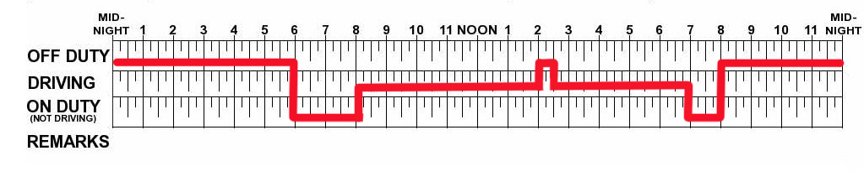
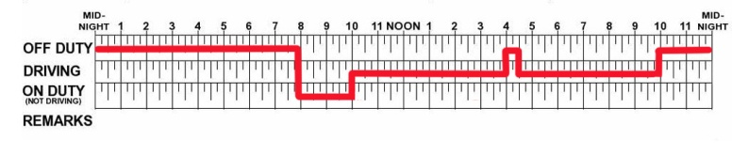
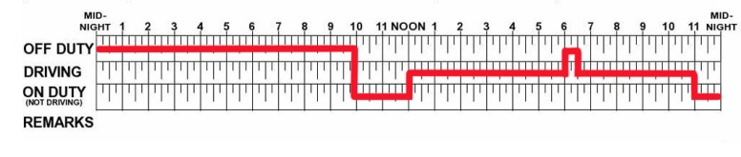
Forward Schedule Rotation
Day 1
Day 2
Day 3
Notes:
Complete Narration: “In forward schedule rotation, work periods are later in successive days. Forward rotation is generally better than backward rotation. Let’s look at an example. In the schematic, a driver alternates 14-hour on-duty periods with 12-hour off-duty periods, thus making the on-duty start time two hours later each day. Most people do not have trouble rotating forward, especially if it means extra time off, as in this example.”
_______
Additional information: Traveling east to west results in a forward rotation of day- and nighttime hours, and thus is like a forward schedule rotation. Most people find this easier than going west to east.

Slide 129
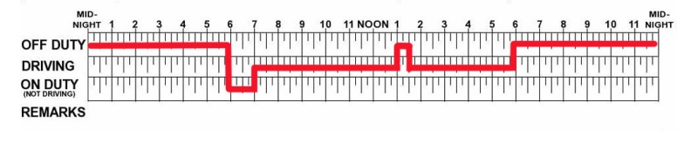
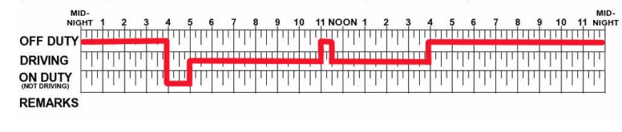
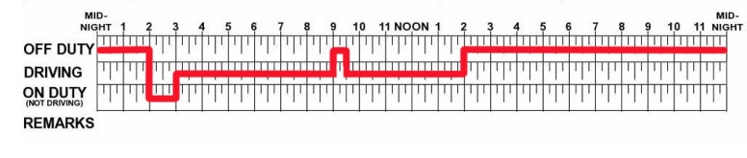
Backward Schedule Rotation
Day 1
Day 2
Day 3
Notes:
Complete Narration: “In backward schedule rotation, work periods are earlier in successive days. Backward rotation is generally worse than forward rotation. In the schematic, a driver alternates 12-hour on-duty periods with 10-hour off-duty periods, thus making the on-duty start time two hours earlier each day. Most people would have trouble with this, even though the on-duty times are less. They would likely have trouble sleeping in the evening, and also trouble staying awake in the pre-dawn hours.”
_______
Additional information: Traveling west to east results in a backward rotation of day- and nighttime hours, and thus is like a backward schedule rotation. It often thrusts you into the next day before you have had sufficient sleep and while you are still in a circadian valley.

Slide 130
U.S. Truck HOS Rules
HOS Element | Rule
Minimum total off-duty hours | 10 consecutive (prior to work shift)
Work shift and/or daily maximum driving hours | 11 (following 10 consecutive hours off-duty; during work shift driving window)
Work shift driving window (beyond which, no driving) | 14
Daily and work shift maximum on-duty hours (beyond which, no driving) | NA
Weekly maximum hours (beyond which, no driving) | 60 in 7 days 70 in 8 days
Restart | 34 consecutive hours
Split sleeper berth hours in 2 periods | 8+ (sleeper berth) and 2+ (off-duty and/or in sleeper berth)
Other | Time spent resting in parked CMV may be off-duty
Notes:
Complete Narration: “This table summarizes some key provisions of the U.S. truck HOS drivers. You are probably already familiar with these rules. A detailed discussion of them is beyond the scope of this instruction, but you should understand a few key features in relation to fatigue management. The daily requirement for 10 hours off-duty affords the opportunity for 7-8 hours of sleep. The combination of 10 (or more) hours off plus 14 (or less) hours on can create a regular 24-hour rest-work cycle, which is ideal. Note also that the 34-hour restart provision is designed to ensure that drivers have at least two main sleep periods during their break. Whenever possible, a weekend break should include at least two full night’s sleep.”
_______
Additional comment: To the extent that specific HOS rules are discussed in your class, try to relate them to fatigue management principles rather than to compliance issues.

Slide 131
U.S. Bus HOS Rules
HOS Element | Rule
Minimum total off-duty hours | 8 consecutive (prior to work shift)
Work shift and/or daily maximum driving hours | 10 (following 8 consecutive hours off-duty; during work shift)
Work shift driving window (beyond which, no driving) | NA
Daily and/or work shift maximum on-duty hours (beyond which, no driving) | 15 (work shift)
Weekly maximum hours (beyond which, no driving) | 60 in 7 days 70 in 8 days
Restart | NA
Split sleeper berth hours in 2 periods | 2+ and 2+ (sleeper berth, both periods); 8 total
Other | Time spent resting in parked CMV may be off-duty
Notes:
Complete Narration: “Here are the U.S. rules for bus drivers. Again, we won’t address specific elements. U.S. bus rules permit greater flexibility but drivers should be aware that taking only 8 hours off on repeated days is likely to result in a sleep debt.”

Slide 132
Canadian Truck & Bus Rules
HOS Element | Rule
Minimum total off-duty hours | 10 (daily minimum); 8 consecutive (prior to work shift); 24 consecutive (within last 14 days)
Work shift and/or daily maximum driving hours | 13 (daily and work shift)
Work shift driving window (beyond which, no driving) | 16 consecutive after starting work shift
Daily and work shift maximum on-duty hours (beyond which, no driving) | 14 (daily and work shift)
Weekly maximum hours (beyond which, no driving) | 70 in 7 days (1) 120 in 14 days (2)
Restart | 36 consecutive hours (1) 72 consecutive hours (2)
Split sleeper berth hours in 2 periods | Single: 2+ and 2+ (sleeper berth, both periods), 10 total. Team: 4+ and 4+ (sleeper berth, both periods), 8 total. 10-hour total daily off-duty limit still applies
Other | Time spent resting in parked CMV may be off-duty
Notes:
Complete Narration: “In Canada, the rules are the same for truck and bus drivers. Ten hours off-duty are required daily, although only 8 must be consecutive prior to a work shift. Daily driving hours and work shift driving windows are greater than in the U.S. Weekly maximum hours and restarts can be based on either 7 or 14 days. There are different sleeper berth rules for single and team drivers.”

Slide 133

HOS Rules
Relatively simple
Generally enforceable
Afford the opportunity for sufficient sleep and rest
“Level the playing field”
Help protect workers
Compliant carriers and drivers have lower crash rates
Notes:
Complete Narration: “They afford drivers the opportunity for sufficient sleep and rest. They “level the playing field” for all drivers and carriers, while helping to protect workers. Finally, there is an association with safety; studies show that compliant carriers and drivers do have lower crash rates.”

Slide 134

Your Alertness and Performance
HOS Compliance
Time awake
Self-awareness
Amount of sleep
Circadian Rhythm
Individual susceptibility
Task & Environmental factors
Notes:
Complete Narration:
“Hours-of-Service compliance is not just legally required. It is important for your alertness and performance as a driver.”
“But in this training we have learned that many other factors contribute to your alertness. Three key ones are amount of sleep, your circadian rhythm, and time awake, especially after 16 hours.”
“Additional factors include your individual susceptibility, task and environmental factors, and your self-awareness of fatigue. HOS compliance is a necessary foundation, but fatigue management involves doing everything you can to optimize all of these factors.”

Slide 135
Driver Obligations
HOS rules are essential
You have two general safety obligations:
  (1) Comply with laws and regulations
  (2) Exercise good judgment beyond just complying with the rules
Similarly, you have two safety obligations relating to sleep and alertness:
  (1) Comply with HOS rules
  (2) Manage your fatigue and alertness beyond HOS compliance
Notes:
Complete Narration: “HOS rules provide the opportunity for adequate rest/sleep. As a professional driver you have two general safety obligations. First you must comply with laws and regulations. Secondly, you must exercise good judgment beyond just complying with the rules. Similarly, you have two safety obligations relating to sleep and alertness. First, comply with HOS rules, and, secondly, manage your fatigue and alertness using the tools and techniques in the FMP. This requires knowledge, self-discipline, and good judgment. You don’t have to drive the maximum hours or take the minimum number of off-duty hours. If you are tired, get more rest.”
_______
Instructor Note: Check on Learning: Q: Which is generally best: a regular schedule, a forward-rotating schedule, or a backward-rotating schedule? A: regular schedule.; Q: Which is generally worst? A: A backward-rotating schedule.”

Slide 136
Team Driving
Topics:
Advantages and disadvantages
Key U.S. and Canadian HOS sleeper berth rules
Compliant and safe sleeper berth use in team driving
Improving team driving
Notes:
Complete Narration: “Team driving has some unique aspects from the fatigue management perspective. We’ll be discussing its advantages and disadvantages; key U.S. and Canadian HOS sleeper berth rules; compliant and safe sleeper berth use in team driving; and ways to improve team driving.”
_______
Additional instructor note:
Learning objectives for this section include:
(K) Identify key advantages and disadvantages of team driving.
(K) Recognize compliant and safe sleeper berth schedules.
(K) Identify general ways to improve team driving.

Slide 137

Team Driving: Advantages
Drivers help each other stay awake
Drivers get more sleep
Drivers can rest when tired
Reduces time-on-task
Team drivers less likely to “push themselves to the limit”
Notes:
Complete Narration: “Let’s discuss the advantages and disadvantages of team driving, starting with advantages. Team drivers generally help each other stay awake. Studies show that team drivers generally get more sleep than solo drivers, in part because they can more easily rest when they are tired. Team driving reduces time-on-task (that is, continuous hours of driving) and team drivers are less likely than solo drivers to “push themselves to the limit.””
_______
Additional information: Advantages and disadvantages based primarily on naturalistic driving study of team and solo drivers (Dingus et al., 2002). Also reviewed in Knipling (2006) and Knipling (2009).

Slide 138
Team Driving: Disadvantages
Poorer quality sleep in moving vehicles
Greater use of split sleep may disrupt sleep patterns
Can mean shorter rest breaks when vehicle is stopped
Can mean greater fatigue at beginning of trip
Notes:
Complete Narration: “But there are some disadvantages. One is poorer quality sleep in moving vehicles compared to stationary ones. Team drivers also make greater use of split sleep, which may disrupt sleep patterns. Team driving can also mean shorter rest breaks when the vehicle is stopped. Finally, it can mean greater fatigue at beginning of the trip if drivers don’t plan ahead and decide who will drive first.”
_______
Additional information: Advantages and disadvantages based primarily on naturalistic driving study of team and solo drivers (Dingus et al., 2002). Also reviewed in Knipling (2006) and Knipling (2009).

Slide 139
Key U.S. Sleeper Berth Rules
Trucks: Drivers using the sleeper berth provision must take at least 8 consecutive hours in the sleeper berth, plus a separate 2 consecutive hours either in the sleeper berth, off duty, or any combination of the two. | Buses: Drivers using a sleeper berth must take at least 8 hours in the sleeper berth, and may split the sleeper-berth time into two periods provided neither is less than 2 hours.
Notes:
Complete Narration: “Here are the key U.S. sleeper berth rules for truck and bus drivers. Take a moment to read them. The standard split for truck drivers is 8 and 2, though bus drivers are given greater flexibility in their splits.”

Slide 140
Key Canadian Sleeper Berth Rules
Single Drivers (Truck or Bus): Single drivers may split their 10 hours off-duty in no more than 2 periods provided that: (a) neither period in the sleeper berth is shorter than 2 hours; (b) the total of the 2 periods in the sleeper berth is at least 10 hours. | Team Drivers (Truck or Bus): Team drivers may split their 10 hours off-duty by spending 2 periods in the sleeper berth to obtain at least 8 or those hours, provided that: (a) neither period in the sleeper berth is shorter than 4 hours; (b) the total of the 2 periods in the sleeper berth is at least 8 hours.
Notes:
Complete Narration: “Canada has the same rules for truck and bus drivers, but makes a distinction between single and team drivers. The standard split for single drivers is 8 and 2. Team drivers are given greater flexibility. Take a moment to review these rules.”

Slide 141
Compliant & Safe
Sleeper Berth Use
Plan sleeper berth periods in advance to be compliant and beneficial
When possible, take sleep periods during circadian valleys
Avoid both caffeine and strenuous activity in hours before breaks
Keep sleeper berth totally dark or use eyeshades
Don’t drive immediately after awakening
Notes:
Complete Narration: “Here are some suggestions for compliant and safe sleeper berth use. Plan your sleeper berth periods in advance so as to be compliant and beneficial. When possible, take sleep periods during circadian valleys. These include 2 to 7 AM and 1 to 4 PM. Avoid both caffeine and strenuous activity in the hours immediately before breaks. Keep the sleeper berth totally dark or use eyeshades. And don’t drive immediately after awakening. Plan for a wake-up period, perhaps with caffeine.”
_______
Additional information: Some drivers like to use a sound machine or fan in the sleeper berth to mask road noise. In regard to circadian valleys: Ordinarily both drivers will not be able to sleep during these periods. Nevertheless, the team should work to ensure that one driver takes advantage of these periods. If a stop is planned where both drivers can sleep, circadian valleys are the best times (especially 2 to 7am).

Slide 142

Improving Team Driving
Team driving is a partnership!
To sleep well, each driver must have full confidence in the other driver
Driver should strive to be “smooth operator”
Agree on a game plan for sleep and rest that meets each driver’s needs
Notes:
Complete Narration: “Here are a few general suggestions for improving team driving. Team driving is a partnership! To sleep well in a moving truck, each driver must have full confidence in the other driver. The driver should strive to be a “smooth operator” so the other person can sleep without interruptions. Finally, agree on a game plan for sleep and rest that meets each driver’s needs.
_______
Instructor Note: Review question on team driving. Q: We cited five advantages of team driving for alertness. Can you state three of them?
A: Any three of these:
Drivers help each other stay awake.
Drivers get more sleep
Drivers can rest when tired
Reduces time-on-task
Team drivers less likely to push themselves to the limit.”

Slide 143
Lesson 4 Quiz
Which would be a good “wind-down” strategy before going to bed?
  Go for a brisk walk
  Turn down overhead lights
  Both a and b
  Neither a nor b
Notes:
Answer: B. Brisk walks are very good for your health, but not just before bedtime.

Slide 144
Lesson 4 Quiz
Of the following, the best time to take a two-hour sleeper berth nap would likely be:
  Early morning (3:00 to 5:00am)
  Mid-morning (8:00 to 10:00am)
  Late morning (10:00 to noon)
  Early evening (6:00 to 8:00pm)
Notes:
Answer: A. This is the lowest circadian valley, and thus when your body most wants to sleep.

Slide 145
Lesson 4 Quiz
Sam works 12 hours on-duty followed by 10 hours off-duty for four days straight. We would say that Sam has:
  A sleep disorder
  A regular 24-hour schedule
  Forward schedule rotation
  Backward schedule rotation
Notes:
Answer: D. He is starting work two hours earlier each successive morning.

Slide 146
Lesson 4 Quiz
Among the important advantages of HOS rules is:
  HOS rules permit sufficient time for driver sleep.
  HOS rules force drivers into irregular schedules.
  HOS rules do not provide for driver individual differences.
  Compliant and non-compliant drivers have equal crash rates.
Notes:
Answer: A. HOS rules provide drivers with an opportunity to get the sleep they need.

Slide 147
Lesson 4 Quiz
Which is true of team driving in comparison with solo driving?
  Team drivers tend to get more sleep.
  Team drivers tend to get higher quality sleep.
  Team drivers more likely to “push themselves to the limit.”
  Team drivers tend to take longer breaks with the vehicle stopped.
Notes:
Answer: A. They tend to sleep more, but sleep quality is worse in a moving vehicle.

Slide 148
Conclusion: Review and Summary
Notes:
Complete Narration: “We are coming to the end of our instruction. We’ll review and then take the module exam.”

Slide 149
Review
Topics:
Key terms and concepts
Myths (misconceptions) about sleep and alertness
Recap of fatigue management “Dos” and “Don’ts”
Notes:
Complete Narration: “Our review will cover key concepts and principles, a few myths or misconceptions about sleep and alertness, and a recap of sleep hygiene “Do’s” and “Don’ts.”

Slide 150
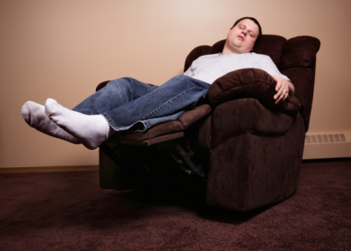
Review: Key Fatigue Terms & Concepts (1 of 2)
Sleep hygiene
Subjective vs. objective self-assessment
Microsleeps
“Drift and jerk” steering
Sleep debts and recovery
Sleep structure
(e.g., Non-REM vs. REM)
Notes:
Complete Narration: “As a review, we have selected 14 key terms and concepts you have learned. Our list includes sleep hygiene, subjective versus objective self-assessment, microsleeps, “drift and jerk” steering, sleep debts and recovery, and sleep structure, including Non-REM and REM sleep. Can you identify or explain each of these concepts? If you can’t go back and review.”
_______
Additional instructor note: Consider going through the list, asking who can define the term and/or explain it. Most can be described briefly and concisely. As instructor, you should be prepared to explain any items or correct any misunderstandings.

Slide 151

Review: Key Fatigue Terms & Concepts (2 of 2)
Internal vs. task-related fatigue
Circadian rhythms
Time awake
Time-on-task
Individual differences in fatigue susceptibility
Sleep disorders (OSA, insomnia)
Forward vs. backward schedule rotation
Notes:
Complete Narration: “Additional topics we have covered include internal versus task-related fatigue, circadian rhythms, time awake, time-on-task, individual differences in fatigue susceptibility, sleep disorders, and forward vs. backward schedule rotation. You should understand and be able to explain these and other concepts presented.”
_______
Additional instructor note: Consider going through the list, asking who can define the term and/or explain it. Most can be described briefly and concisely. As instructor, you should be prepared to explain any items or correct any misunderstandings.

Slide 152
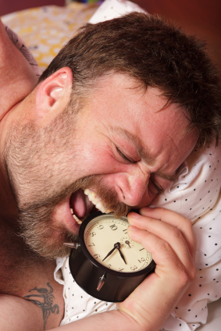
Fatigue Myths (1 of 2)
“I can discipline myself to get by with less sleep”
“I can motivate myself to push through even though I’m sleepy”
“I’ve lost sleep before and done just fine”
“I know how sleepy I am”
Notes:
Complete Narration: “There are a lot of myths and misconceptions about fatigue and sleep. Here are four of them.
#1: “I can discipline myself to get by with less sleep.” In fact, sleep is a biological need. Few people can sustain top performance with less sleep than their bodies want.
#2: “I can motivate myself to push through even though I’m sleepy.” Motivation does not greatly increase performance for sleep deprived people and sleep deprivation reduces motivation.
#3: “I’ve lost sleep before and done just fine.” A person can be lucky for a long time but crash odds increase the longer you drive drowsy.
#4: “I know how sleepy I am.” Recall the research evidence showing that subjective self-assessments of alertness level are often inaccurate. If you feel sleepy, you are sleepy. But most sleepy drivers don’t realize how sleepy they are.”
_______
Additional instructor note: As instructor, you should be prepared to explain any items or correct any misunderstandings.

Slide 153
Fatigue Myths (2 of 2)
“I can always just open the windows and turn up the radio”
“A nap will only make it worse”
“Alcohol helps me sleep”
“Dealing with driver fatigue is easy”
Notes:
Complete Narration: “Here are four more fatigue myths:
#5: “I can always just open the windows and turn up the radio.” Stimulation such as loud music does little to keep you awake while driving if you are short of sleep and showing signs of fatigue.
#6: “A nap will only make it worse.” In fact, almost any nap or additional sleep will help you perform better.
#7: “Alcohol helps me sleep.” Alcohol may make you sleepy at first but is generally disruptive to sleep.
#8: “Dealing with driver fatigue is easy.” In fact, there is a lot to know about fatigue, and it is difficult to balance work and other life demands with sleep needs.”
_______
Additional instructor note: As instructor, you should be prepared to explain any items or correct any misunderstandings.

Slide 154
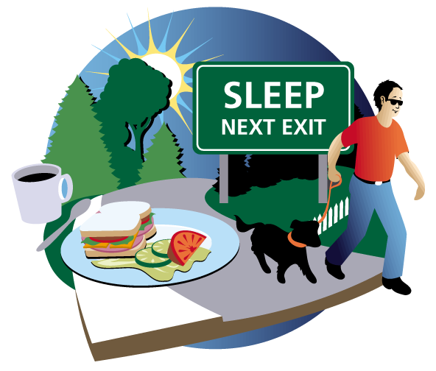
Fatigue Management “Do’s”
(1 of 2)
Value alertness and wellness
Recognize sleep as a main ingredient
Be aware of the fatigue factors affecting you at any time
Self-assess your fatigue level based on objective signs
Try to “go with” your circadian rhythms, not against them
Use dark and light as aids to fatigue management
Notes:
Complete Narration: “This slide and the next one review some sleep hygiene “Do’s.”
First, value alertness and wellness, and
Recognize sleep as a main ingredient.
Be aware of the fatigue factors affecting you at any time.
Self-assess your fatigue level based on objective signs, not just your subjective sense of how tired you are.
Try to “go with” your circadian rhythms, not against them.
And use dark and light as aids to fatigue management.”
_______
Additional instructor note: As with the previous slides, consider going through the list, asking students if they can explain each item. Or you might just select a few of them for discussion. As instructor, you should be prepared to explain any items or correct any misunderstandings. Examples: What are the fatigue factors affecting you at any time? How can you use darkness as an aid to fatigue management? How can you use light?

Slide 155
Fatigue Management “Do’s”
(2 of 2)
Seek OSA screening if you have risk factors
Follow the 5 keys to wellness
Use caffeine wisely
Be cautious about other drugs
Take breaks, especially with naps
Comply with HOS rules
Wear your safety belt!
Notes:
Complete Narration: “In addition, seek OSA screening if you have risk factors. Follow the 5 keys to wellness. Use caffeine wisely.
Be cautious about other drugs. Take breaks, especially with naps. Comply with HOS rules. And wear your safety belt!”
_______
Additional instructor note: As with the previous slides, consider going through the list, asking students if they can explain each item. Or you might just select a few of them for discussion. As instructor, you should be prepared to explain any items or correct any misunderstandings. Examples: Can you name the five keys to wellness (Optional hint: The first was nutrition)? Why is a nap better than a break without a nap?

Slide 156

Fatigue Management “Don’ts”
Ignore signs of fatigue
Use caffeine excessively
Use alcohol as a sleep aid
Eat heavy meals before driving
Rotate your daily work-rest schedule backwards (when you can avoid it)
Exercise strenuously just before sleep periods
Let a sleep debt worsen
Set the alarm clock on weekends
Notes:
Complete Narration: “And of course there are sleep hygiene “Don’ts.” Don’t ignore signs of fatigue (especially objective signs).
Don’t use caffeine excessively (or too close to sleep periods). Don’t use alcohol as a sleep aid, or eat heavy meals before driving. Try not to rotate your daily work-rest schedule backwards. Exercise is great, but don’t exercise strenuously just before sleep periods. Don’t let a sleep debt worsen over multiple days, and try not to set the alarm clock on weekends. Most of all, don’t forget that asleep-at-the-wheel crashes are one of the biggest killers of CMV drivers!.”
_______
Additional instructor note: As with the previous slides, consider going through the list, asking students if they can explain each item. Or you might just select a few of them for discussion. As instructor, you should be prepared to explain any items or correct any misunderstandings. Examples: Why is alcohol bad for sleep? Why is it better to not set the alarm on weekends?

Slide 157
Module 3 Exam
Instructions
30-question exam

